Slide 1
Laravel 5
Intermediate & Advanced
IT GENIUS ENGINEERING

Slide 2

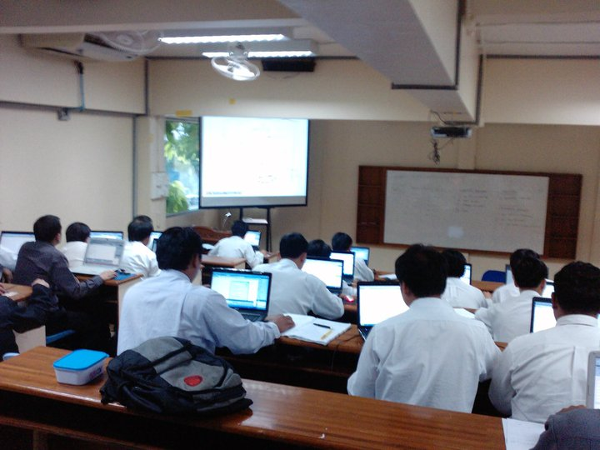
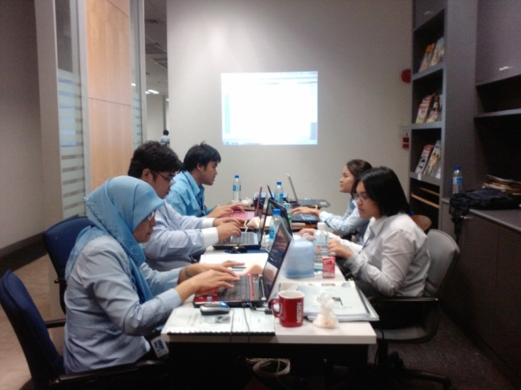
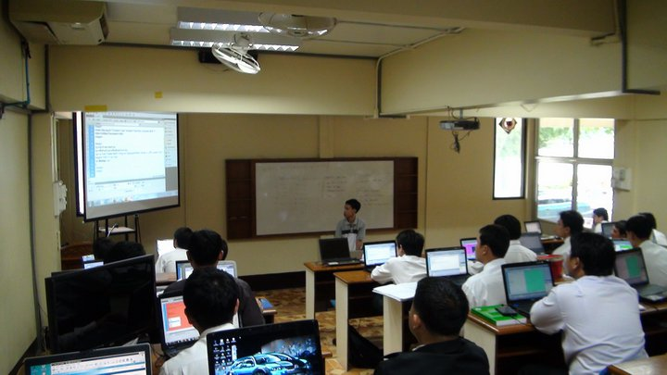
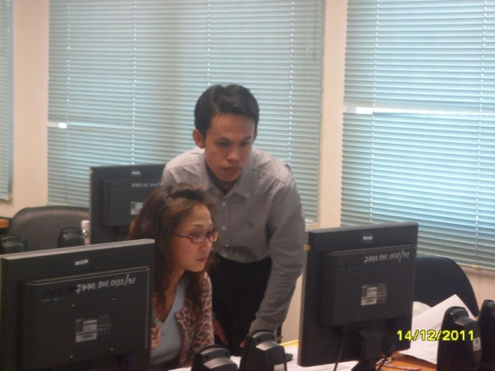
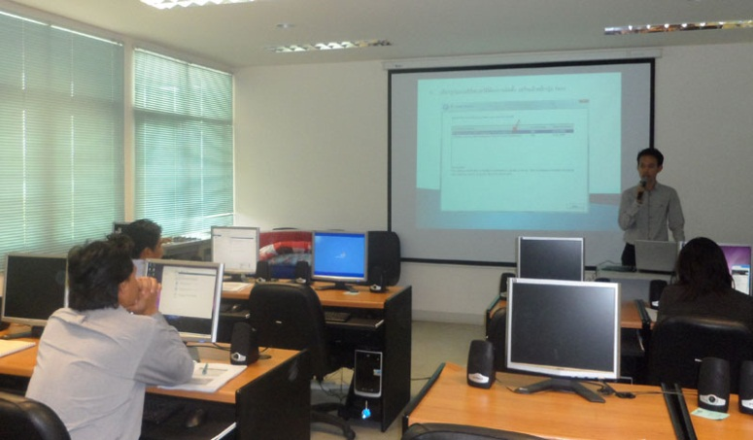
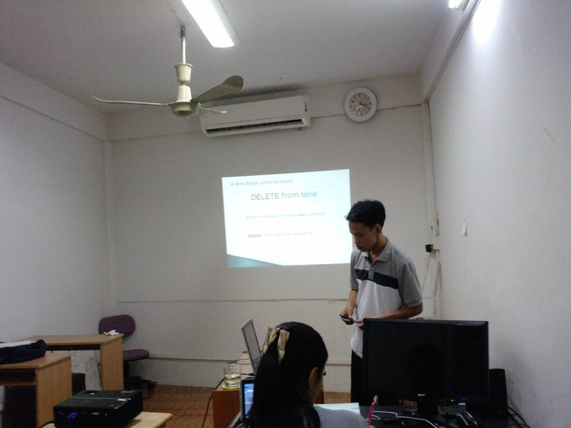
วิทยากร
อาจารย์สามิตร โกยม (ป่าน)
ปริญญาโทคณะเทคโนโลยีสารสนเทศ
มหาวิทยาลัยเทคโนโลยีพระจอมเกล้าพระนครเหนือ
www.itgenius.co.th | 02-933-0427 , 088-807-9770

Slide 3
Course Outline
IT GENIUS ENGINEERING

Slide 4
Course Outline
Intermediate
Customizing Structure Laravel 5
Blade template customize
Incremental Validation
Many to Many Relationships
RESTful Resource Controllers
Custom Mailers
Search Essentials
File Uploads With Laravel 5
What is a Laravel Interface
Model Events and Model Observers
Form Macros
Crons and Email
Recurring Tasks The Laravel Way
Laravel 5 Command Bus
Laravel 5 Preview Events
Laravel 5 Eloquent Global Scope
IT GENIUS ENGINEERING

Slide 5
Course Outline
Advanced
Advanced Routing in Laravel 5
Laravel 5 CRUD with Resource Controllers
Advanced Data Validation in Laravel 5
Custom Generators for Laravel 5
Acceptance Testing
Beanstalkd Queues
Building User Profiles
Coding With Intent
PHPUnit Testing
Export an Eloquent Collection to a CSV with League CSV
CREATE PDF (USE DOMPDF)
Commander Domain Events
Commands and Crons
Continuous Integration
Controller Cleanup
Custom Facades and Searching
DI Containers
Favorites
Hands-On Payment History
Integration Testing With Factories
Introducing-Laravel-Commander
Laravel multiple auth
Live Workshop
IT GENIUS ENGINEERING

Slide 6
Intermediate
IT GENIUS ENGINEERING

Slide 7
Sublime Text Install Package

Slide 8
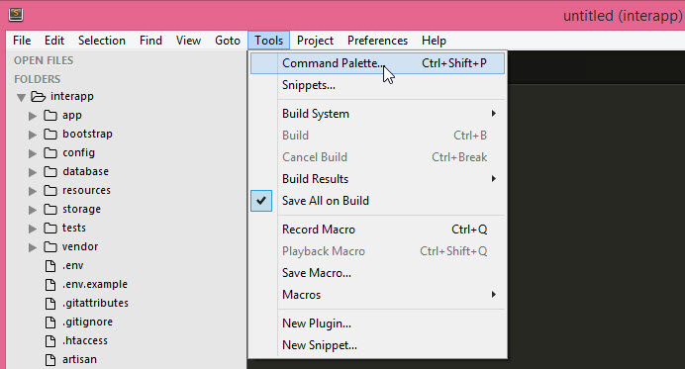
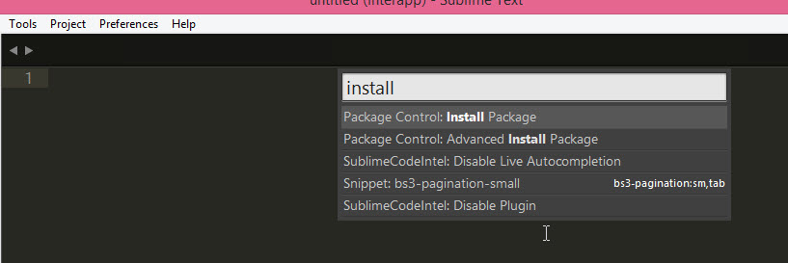
Sublime Text install Package
Tools > Command Palette…
Type: install
IT GENIUS ENGINEERING

Slide 9
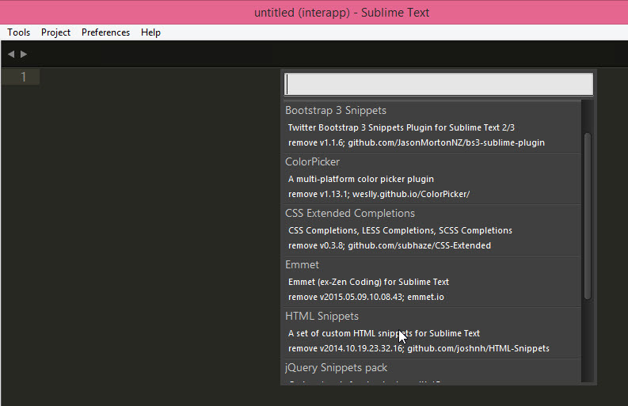
Sublime Text install Package
All AutoComplete
Bootstrap 3 Snippets
ColorPicker
HTML Snippets
IT GENIUS ENGINEERING

Slide 10
Customizing Laravel 5 Structure

Slide 11
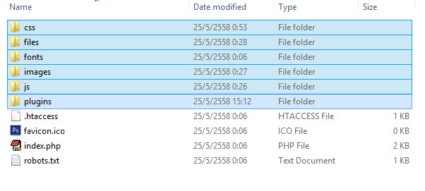
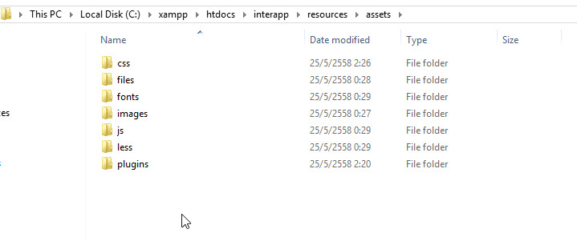
Customizing Structure Laravel 5
ปรับแต่งโครงสร้างของ Laravel 5 โดยจะให้เรียกใช้งานได้จาก root directory (ไม่ต้องเรียกผ่าน public folder)
Step 1: เข้าไปทำการ move folder จากใน public folder ดังภาพ
Step 2: นำไปวางไว้ใน resource/assets ดังภาพ
IT GENIUS ENGINEERING

Slide 12
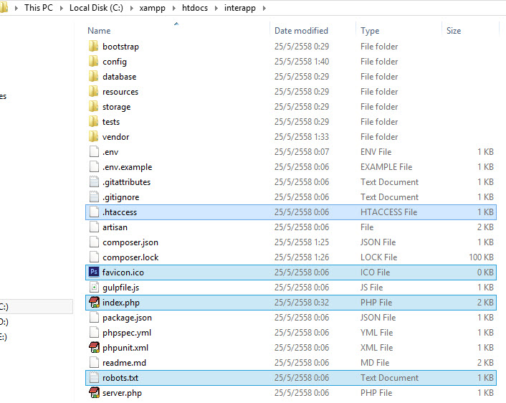
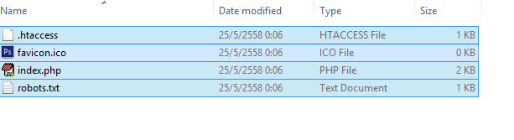
Customizing Structure Laravel 5
Step 3: ทำการ move ไฟล์ทั้งหมดที่เหลือใน public folder ไปวางไว้ที่ Root directory
Step 4: วางไว้ที่ root directory ดังภาพ
IT GENIUS ENGINEERING

Slide 13
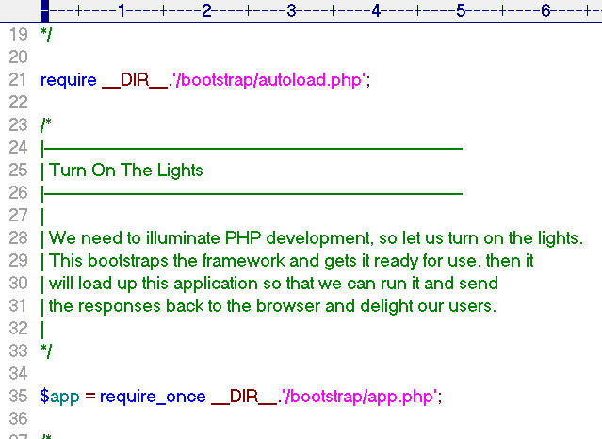
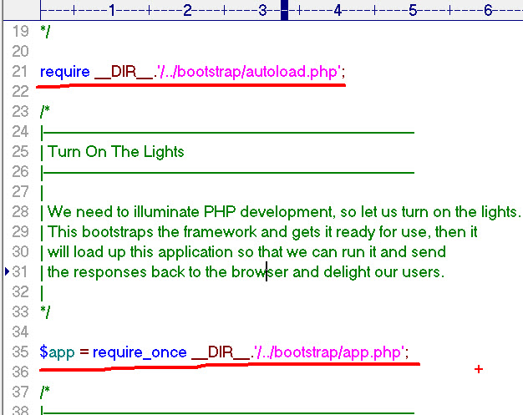
Customizing Structure Laravel 5
Step 5: ทำการลบ folder public ทิ้งไป
Step 7: แก้ไขภาพเป็นดังภาพ
Step 6: เปิดไฟล์ index.php ที่ root ขึ้นมา เพื่อแก้ไข path สองจุดนี้
IT GENIUS ENGINEERING

Slide 14

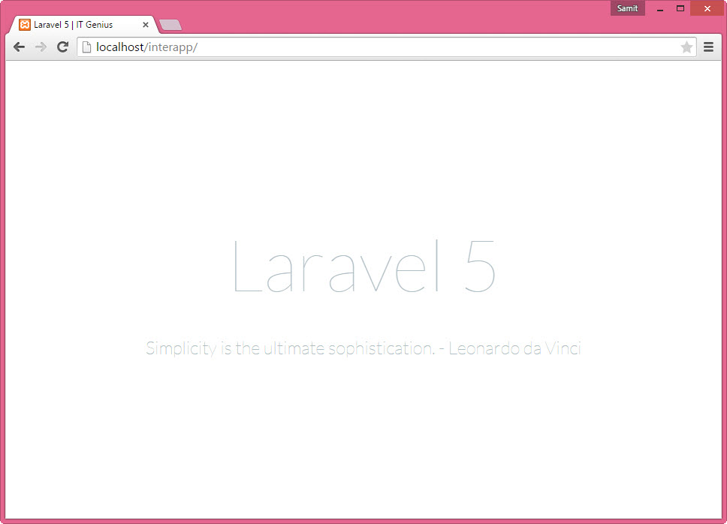
Customizing Structure Laravel 5
Step 8: ทดสอบเรียกใช้งาน
รู้ไว้ใช่ว่า ?
หากติดตั้ง Larave 5 บน Hosting จริง
จะต้องมีการ change permission ให้
กับ folder app/storage/log และ bootstrap เป็น 777
รวมทั้งควรปรับ APP_DEBUG=false
ไว้ด้วย
IT GENIUS ENGINEERING

Slide 15
Blade template customize

Slide 16
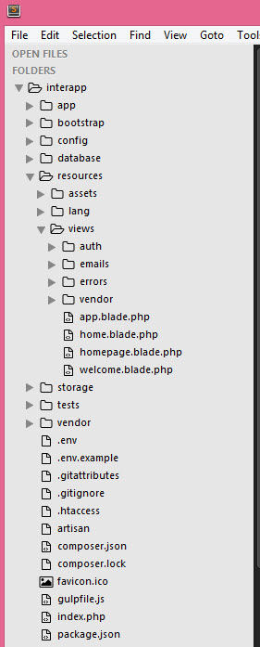
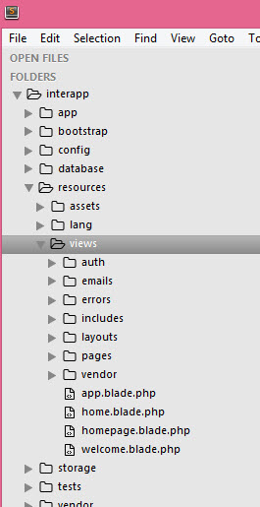
Blade template customize
Laravel 5 Structure
Create directory in views
- includes
- layouts
- pages
IT GENIUS ENGINEERING

Slide 17
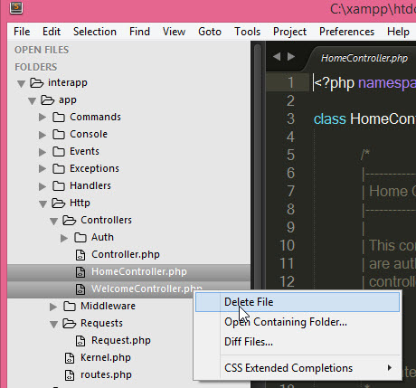
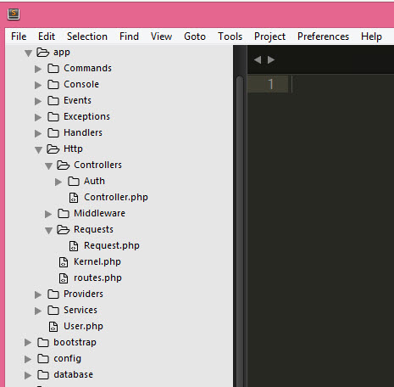
Blade template customize
ลบ controller เดิมทิ้งไป
IT GENIUS ENGINEERING

Slide 18
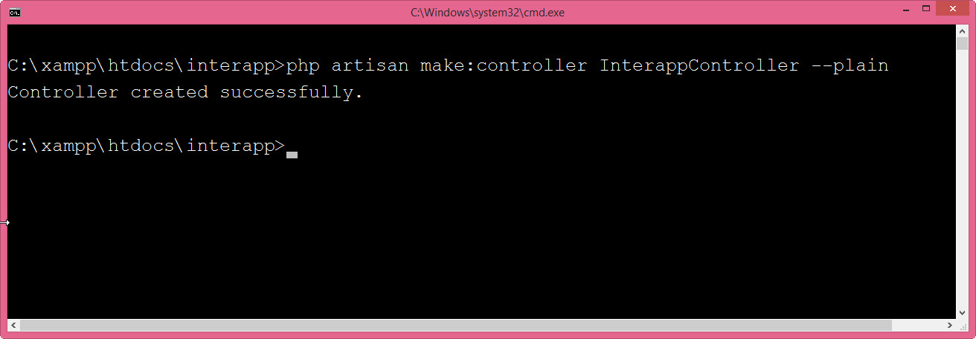
Blade template customize
Create Controller
php artisan make:controller [Name]Controller --plain
php artisan make:controller InterappController --plain
IT GENIUS ENGINEERING

Slide 19
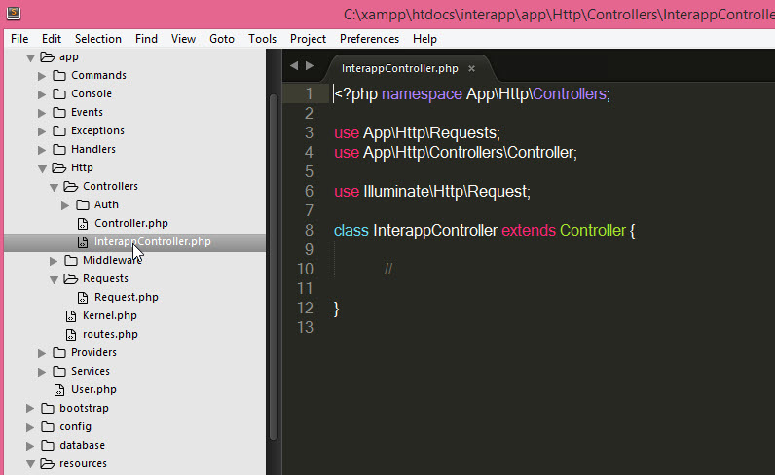
Blade template customize
IT GENIUS ENGINEERING

Slide 20
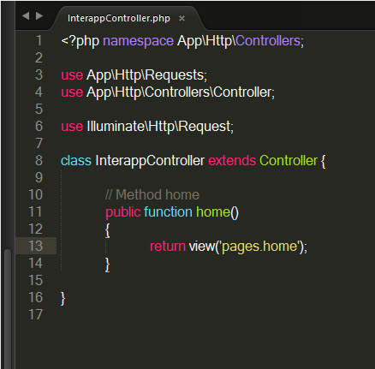
Blade template customize
<?php namespace App\Http\Controllers;
use App\Http\Requests;
use App\Http\Controllers\Controller;
use Illuminate\Http\Request;
class InterappController extends Controller {
// Method home
public function home()
{
return view('pages.home');
}
}
IT GENIUS ENGINEERING

Slide 21
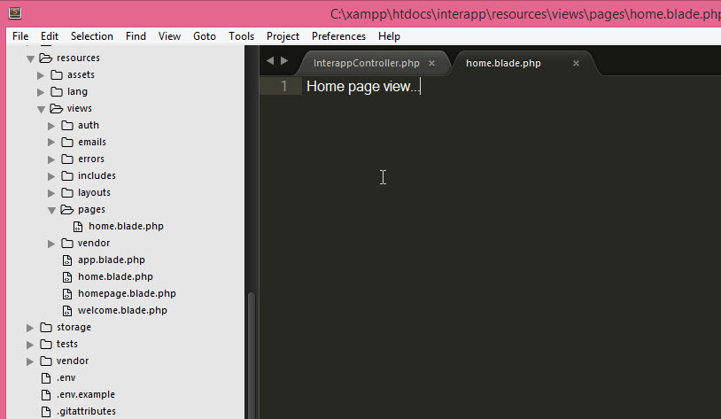
Blade template customize
Create home.blade.php in pages folder
IT GENIUS ENGINEERING

Slide 22
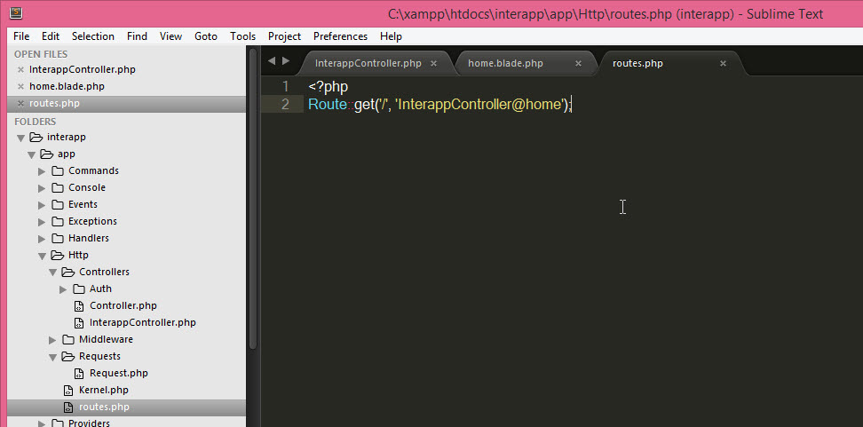
Blade template customize
Set routes.php
<?php
Route::get('/', 'InterappController@home');
IT GENIUS ENGINEERING

Slide 23
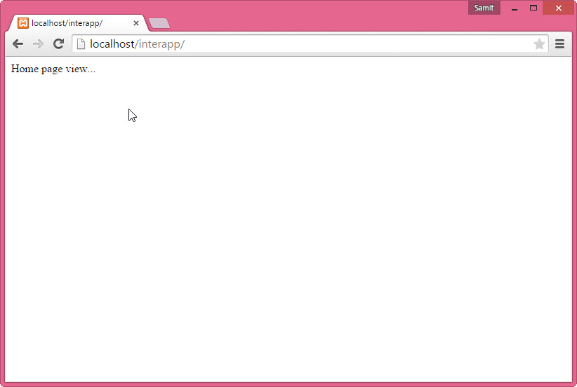
Blade template customize
ทดสอบดูผลลัพธ์
IT GENIUS ENGINEERING

Slide 24
Blade template customize
Interapp site structure
interapp
Home
About us
Services
Portfolio
Blog
Contact
IT GENIUS ENGINEERING

Slide 25
Blade template customize
Home page wireframe
InterApp
Home About us Services Portfolio Blog Contact
Picture
@2014-2015 InterApp All right reserve
www.interapp.com
IT GENIUS ENGINEERING

Slide 26
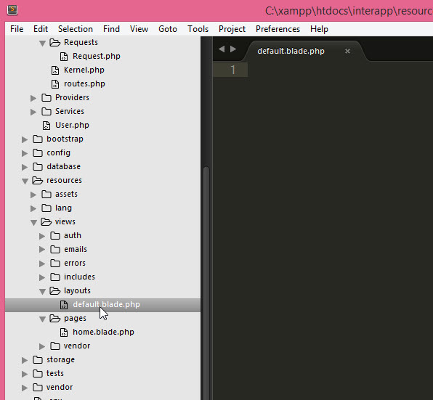
Blade template customize
สร้าง layout หลักที่ folder layouts
<!doctype html>
<html>
<head>
@include('includes.head');
</head>
<body>
@include('includes.header');
<!-- BEGIN PAGE CONTENT -->
<div class="container-fluid">
@yield('content')
</div>
<!-- END PAGE CONTAINER -->
@include('includes.footer')
@include('includes.footer_asset')
</body>
</html>
IT GENIUS ENGINEERING

Slide 27
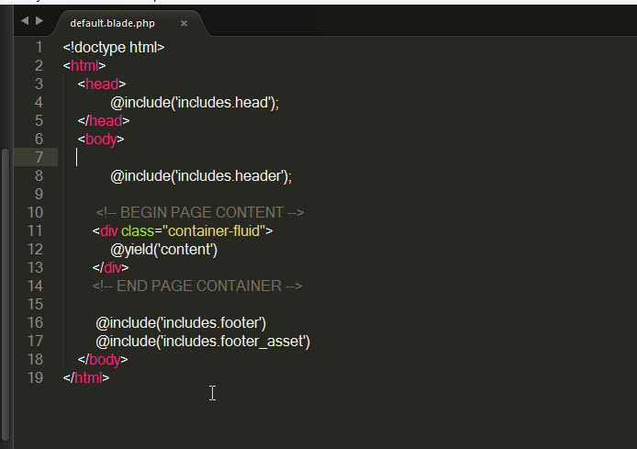
Blade template customize
สร้าง layout หลักที่ folder layouts
IT GENIUS ENGINEERING

Slide 28
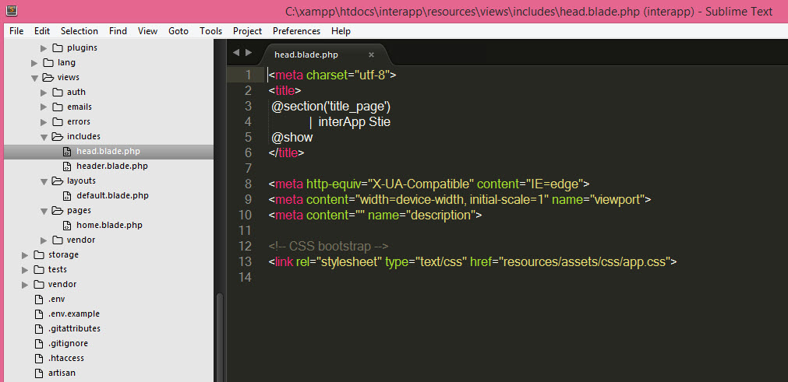
Blade template customize
สร้าง head,header,footer,footer_asset
IT GENIUS ENGINEERING

Slide 29
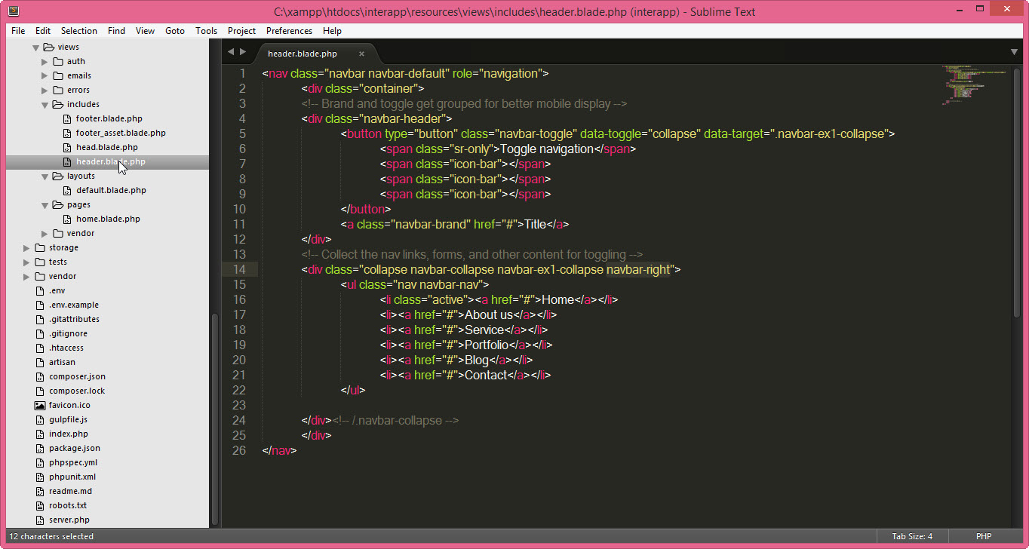
Blade template customize
IT GENIUS ENGINEERING

Slide 30
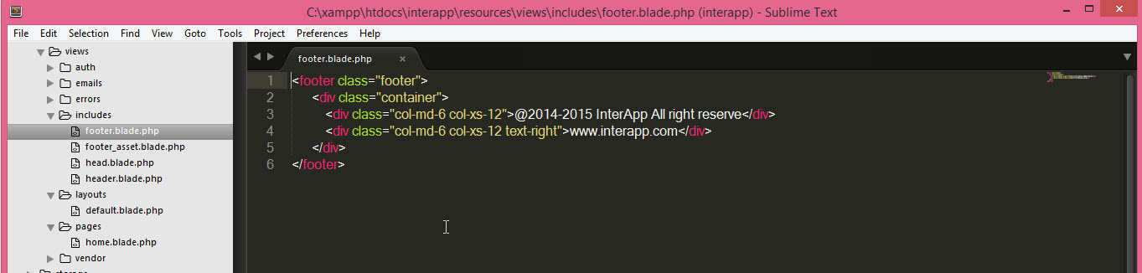
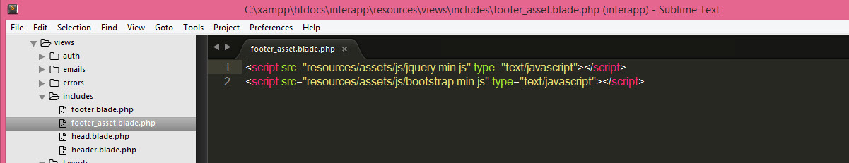
Blade template customize
IT GENIUS ENGINEERING

Slide 31
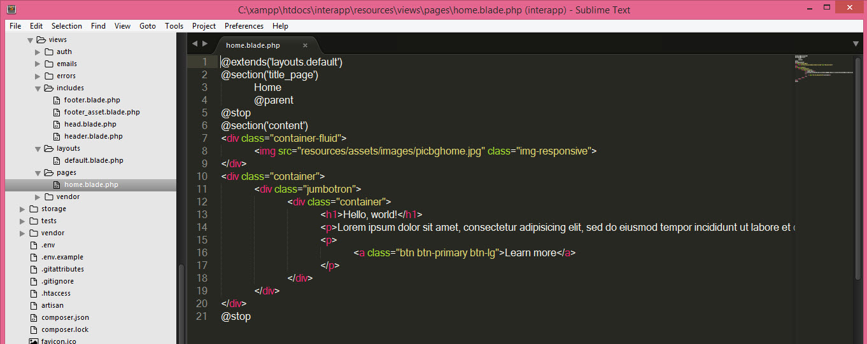
Blade template customize
IT GENIUS ENGINEERING

Slide 32
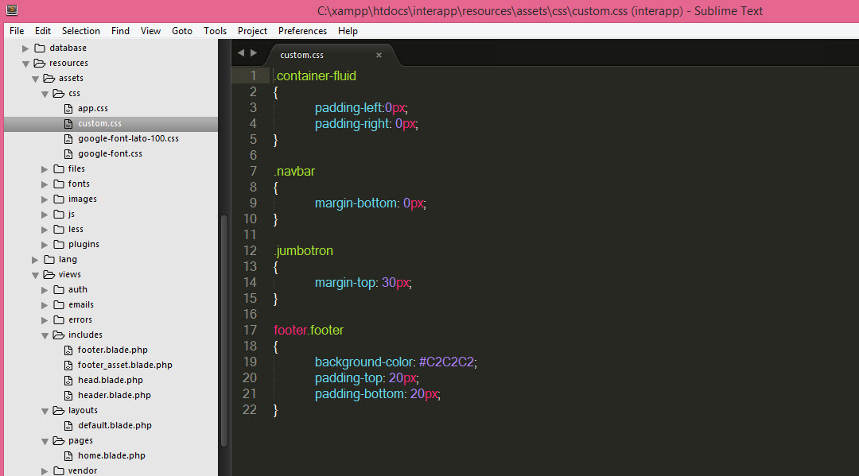
Blade template customize
IT GENIUS ENGINEERING

Slide 33
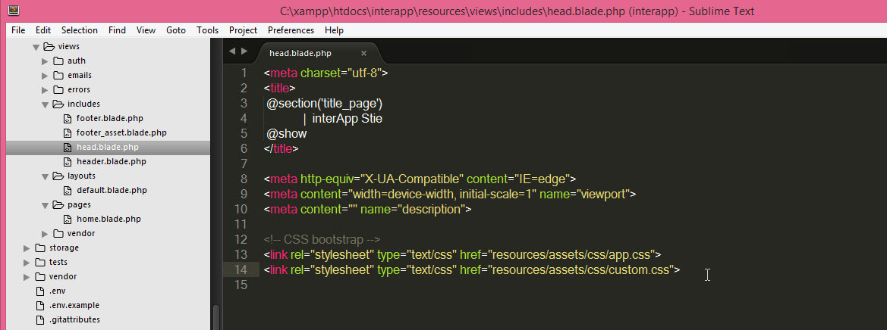
Blade template customize
IT GENIUS ENGINEERING

Slide 34
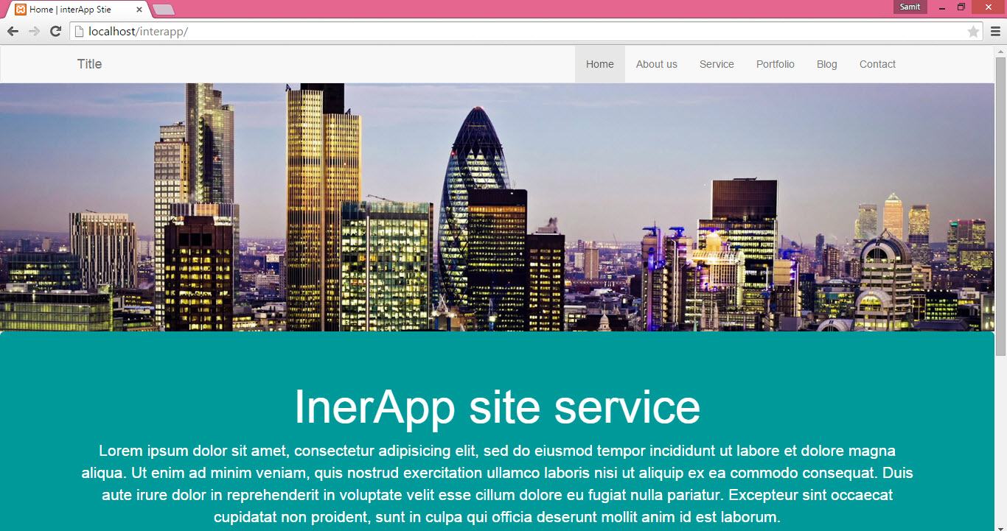
Blade template customize
IT GENIUS ENGINEERING

Slide 35
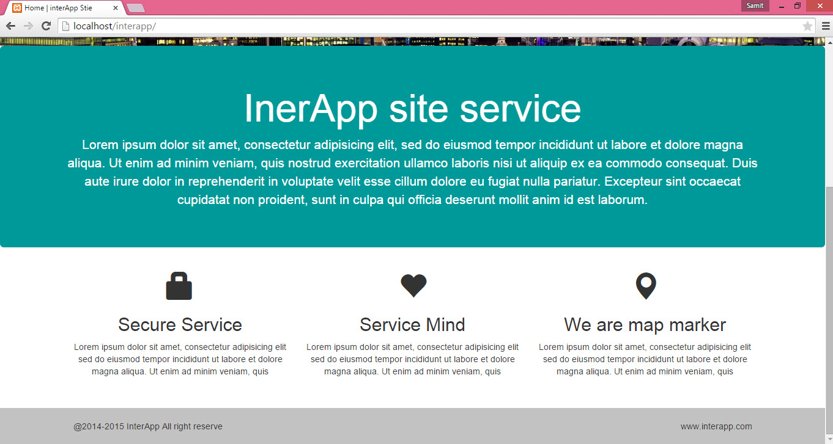
Blade template customize
IT GENIUS ENGINEERING

Slide 36
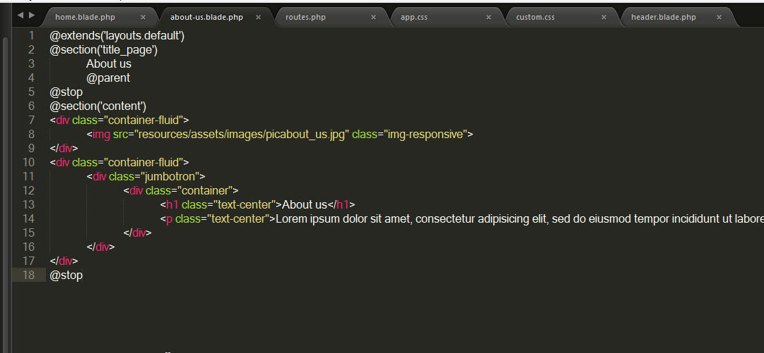
Blade template customize
Add another page (About us, Service, Portfolio , Blog , Contact)
IT GENIUS ENGINEERING

Slide 37
Blade template customize
Set routes.php
<?php
Route::get('/', 'InterappController@home');
Route::get('about-us', function()
{
return View::make('pages.about-us'); // แบบที่ 1
//return response()->view('pages.about-us'); // แบบที่ 2
});
IT GENIUS ENGINEERING

Slide 38
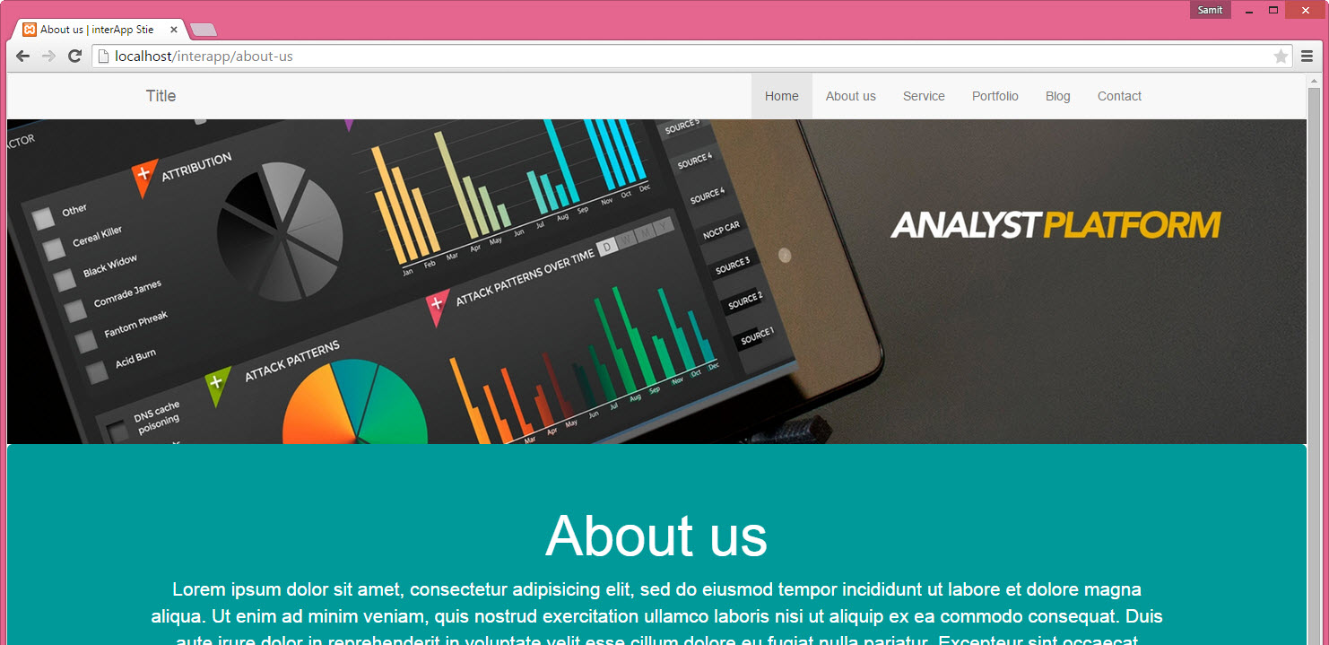
Blade template customize
Add link menu
<li class="active"><a href="{{URL::to('/')}}">Home</a></li>
<li><a href="{{URL::to('about-us')}}">About us</a></li>
IT GENIUS ENGINEERING

Slide 39
Blade template customize
Set Active class to menu
header.blade.php
<li @section('active_home')@show><a href="{{URL::to('/')}}">Home</a></li>
<li @section('active_about')@show><a href="{{URL::to('about-us')}}">About us</a></li>
home.blade.php
about-us.blade.php
@section('active_home')
class="active"
@stop
@section('active_about')
class="active"
@stop
IT GENIUS ENGINEERING

Slide 40
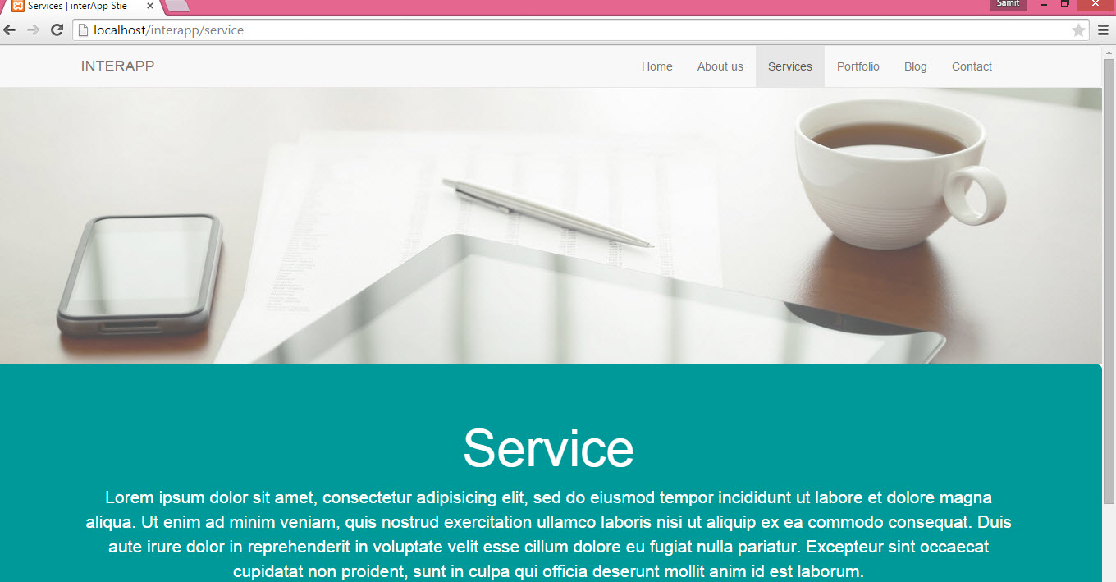
Blade template customize
Service page
IT GENIUS ENGINEERING

Slide 41
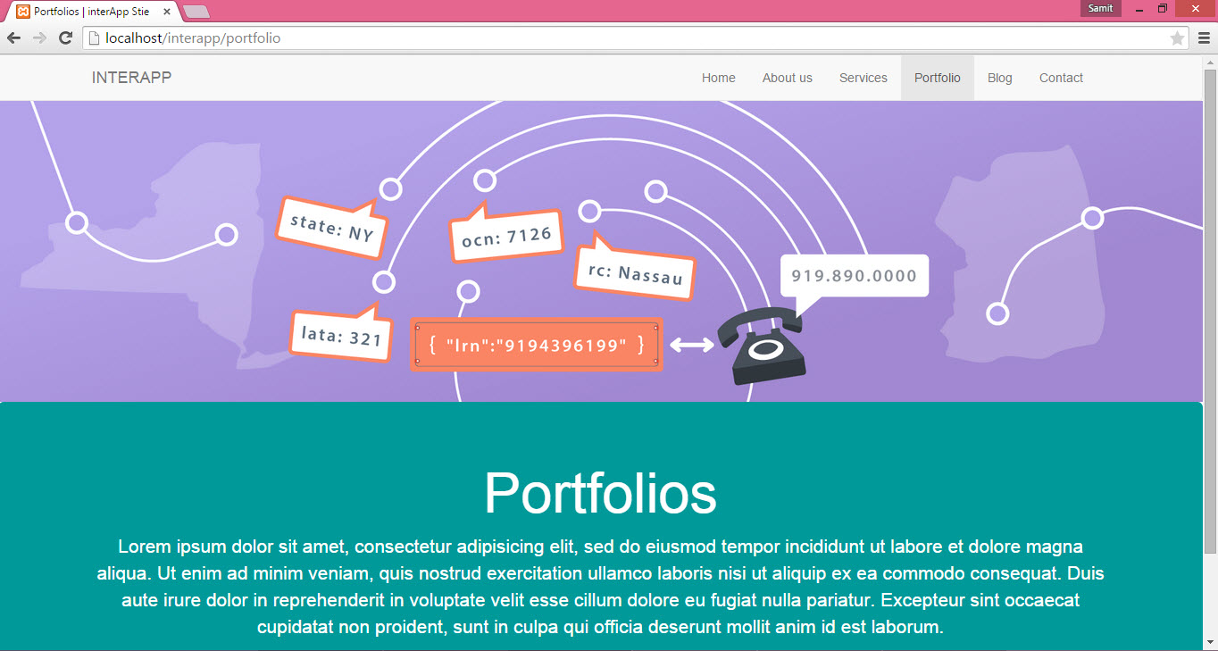
Blade template customize
Portfolio page
IT GENIUS ENGINEERING

Slide 42
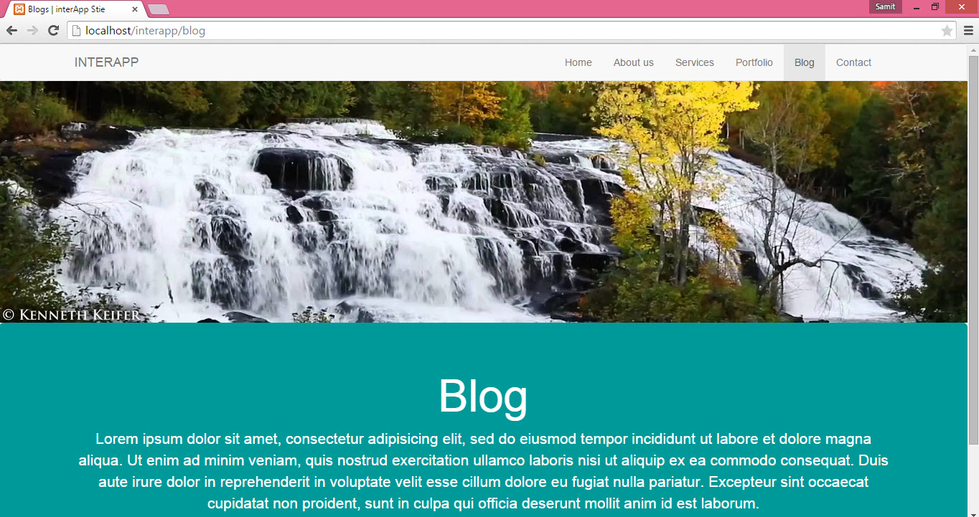
Blade template customize
Blog page
IT GENIUS ENGINEERING

Slide 43
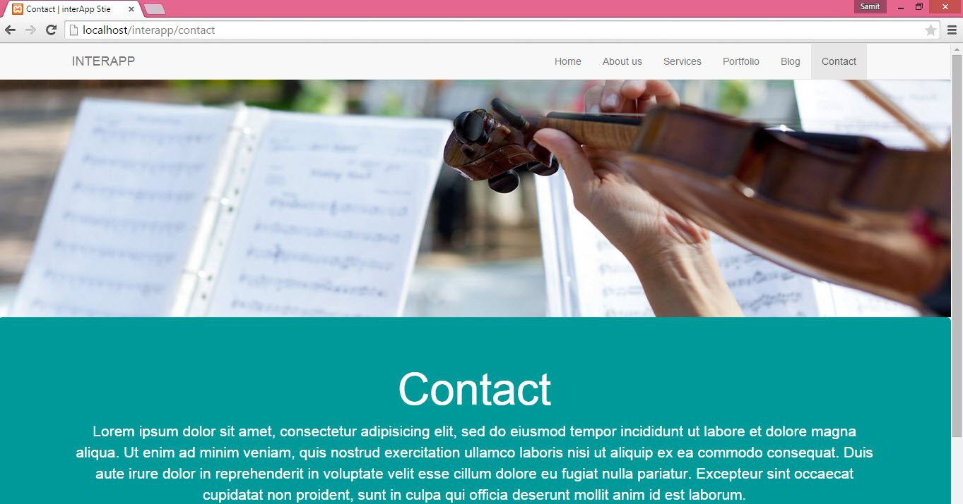
Blade template customize
Contact page
IT GENIUS ENGINEERING

Slide 44
Tip for Trailling Slashes Prolblem

Slide 45
ปัญหาเมื่อวาง / ต่อท้าย URL
เมื่อมีการเติม / ต่อท้าย URL จะทำให้เกิดการ Redirect ไปที่ root ทันที แนวทางแก้ปัญหานี้คือ
1. แก้ไฟล์ .htaccess
# Redirect Trailing Slashes...
#RewriteRule ^(.*)/$ /$1 [L,R=301] // ปิดการทำงานบรรทัดนี้ไป
2. แก้ path ของ resource ต่าง ๆ เป็นดังนี้
<link rel="stylesheet" type="text/css" href="{{URL::asset('resources/assets/css/app.css')}}">
<script src="{{URL::asset('resources/assets/js/jquery.min.js')}}" type="text/javascript"></script>
<img src="{{URL::asset('resources/assets/images/picservice.jpg')}}" class="img-responsive">
IT GENIUS ENGINEERING

Slide 46
Incremental Validation

Slide 47
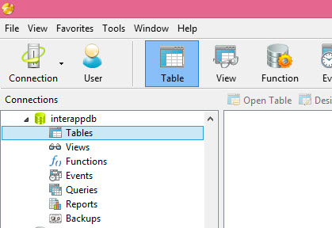
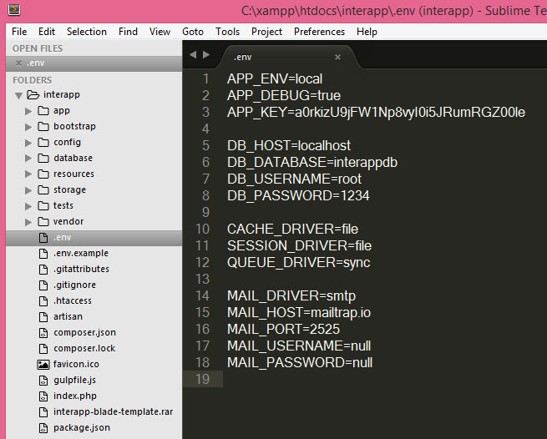
Incremental Validation
Create Database (MySQL)
Config .env file
APP_ENV=local
APP_DEBUG=true
APP_KEY=a0rkizU9jFW1Np8vyI0i5JRumRGZ00le
DB_HOST=localhost
DB_DATABASE=interappdb
DB_USERNAME=root
DB_PASSWORD=1234
CACHE_DRIVER=file
SESSION_DRIVER=file
QUEUE_DRIVER=sync
MAIL_DRIVER=smtp
MAIL_HOST=mailtrap.io
MAIL_PORT=2525
MAIL_USERNAME=null
MAIL_PASSWORD=null
DB Name: interappdb
IT GENIUS ENGINEERING

Slide 48
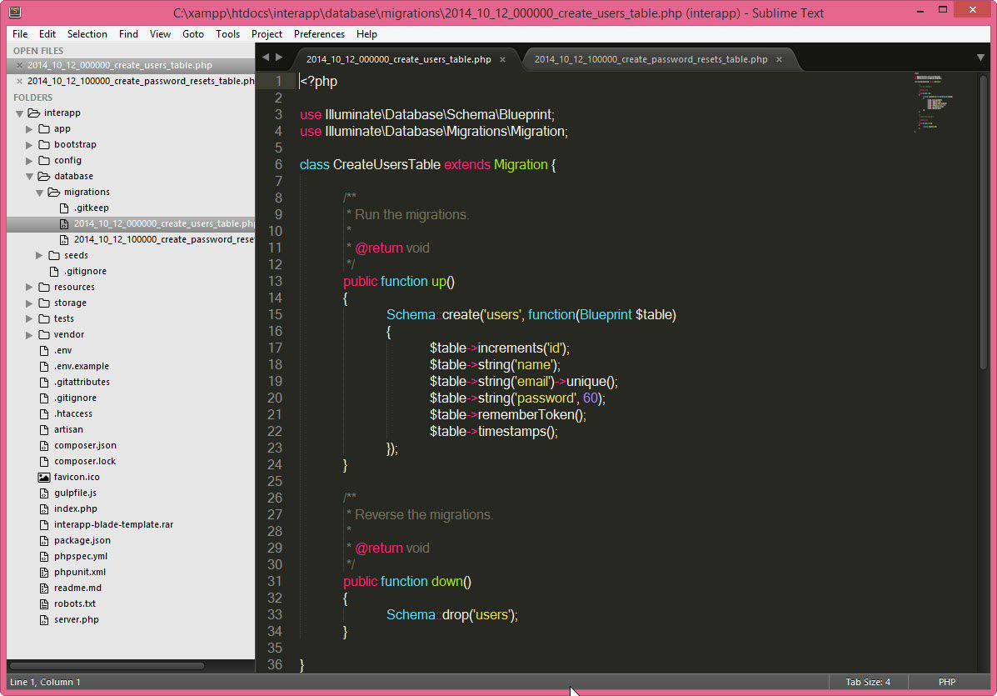
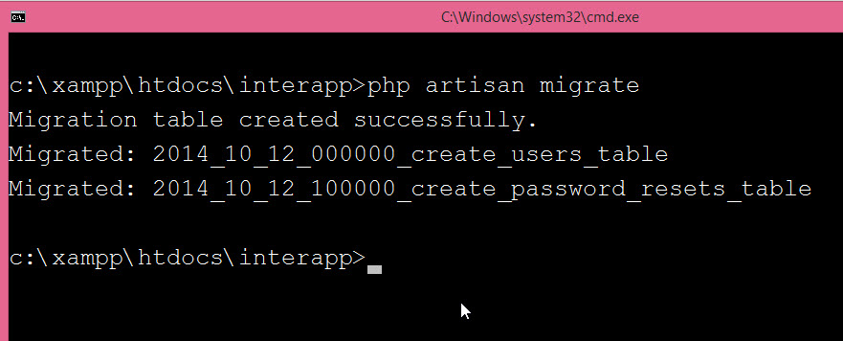
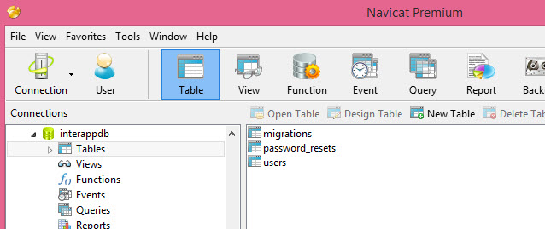
Incremental Validation
Migrations
คำสั่ง migrate
php artisan migrate
IT GENIUS ENGINEERING

Slide 49
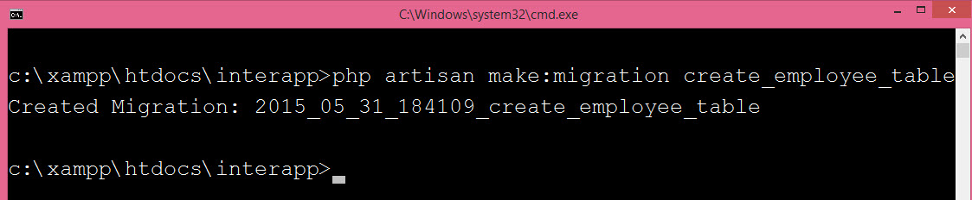
Incremental Validation
Create migration for new table
php artisan make:migration create_employee_table
IT GENIUS ENGINEERING

Slide 50
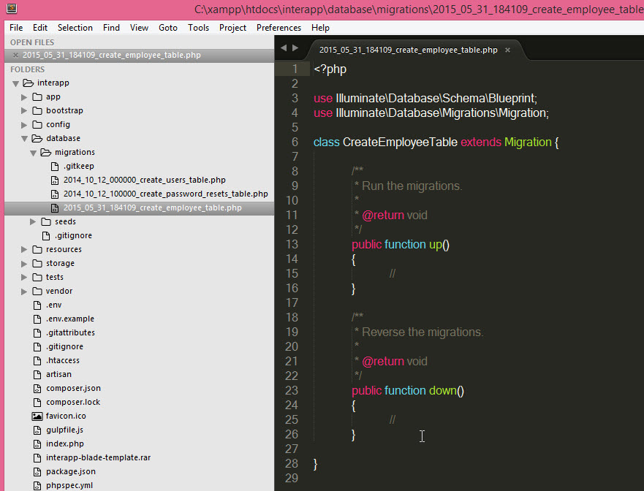
Incremental Validation
Create migration for new table
public function up()
{
Schema::create('employee', function(Blueprint $table)
{
$table->increments('id');
$table->string('fullname',128);
$table->string('gender',10);
$table->string('email',50)->unique();
$table->string('tel',30);
$table->integer('age');
$table->text('address');
$table->string('avartar',128);
$table->integer('status');
});
}
IT GENIUS ENGINEERING

Slide 51


Incremental Validation
Create migration for new table
php artisan migrate
IT GENIUS ENGINEERING

Slide 52

Incremental Validation
Create Register form
<div class="container">
<div class="col-md-6">
<div class="panel panel-primary">
<div class="panel-heading">
<h3 class="panel-title">Register</h3>
</div>
<div class="panel-body">
<form action=“register" method="POST" role="form">
<input type="hidden" name="_token" value="{{{csrf_token()}}}"> ....
</form>
</div>
</div>
</div>
<div class="col-md-6">
<div class="panel panel-success">
<div class="panel-heading">
<h3 class="panel-title">Login</h3>
</div>
<div class="panel-body">
<form action=“login" method="POST" role="form">
<input type="hidden" name="_token" value="{{{csrf_token()}}}"> ....
</form>
</div>
</div>
</div>
</div>
IT GENIUS ENGINEERING

Slide 53

Incremental Validation
Create Model
public $timestamps = false;
protected $table = 'employee';
protected $fillable = [
'fullname',
'gender',
'email',
'tel',
'age',
'address',
'status'
];
php artisan make:model Employee --no-migration
IT GENIUS ENGINEERING

Slide 54
Incremental Validation
Route post register
Route::post('register', 'InterappController@register_post');
Controller register_post
<?php namespace App\Http\Controllers;
use App\Http\Requests;
use App\Http\Controllers\Controller;
use App\Employee;
use Illuminate\Support\Facades\Request;
public function register_post(){
$input = Request::all();
Employee::create($input);
return redirect('register');
}
IT GENIUS ENGINEERING

Slide 55
Incremental Validation
Validation form
InterappController.php
$messages = [
'required' => 'ข้อมูล :attribute จำเป็น',
'email' => 'รูปแบบ :attribute ไม่ถูกต้อง ',
'unique' => 'ข้อมูล :attribute ซ้ำ',
'numeric' => 'ข้อมูล :attribute ต้องเป็นตัวเลขเท่านั้น',
'min' => 'ข้อมูล :attribute ต้องไม่น้อยกว่า :min ตัว',
];
$rules = [
'fullname' => 'required',
'gender' => 'required|in:male,female',
'email' => 'required|email|unique:employee',
'tel' => 'required|numeric',
'age' => 'required|numeric',
'address' => 'required|Min:5'
];
$validator = Validator::make(Request::all(),$rules,$messages);
if($validator->fails()){
return redirect()->back()
->withErrors($validator)->withInput();
}else{
$input = Request::all();
Employee::create($input);
return redirect('register');
}
IT GENIUS ENGINEERING

Slide 56

Incremental Validation
Validation form
IT GENIUS ENGINEERING

Slide 57
Eloquent To String

Slide 58
Eloquent To String
public function view_employee()
{
//Find
//$emp = Employee::all();
//$emp = Employee::find(1);
//$emp = Employee::find(array(1,2));
//$emp = Employee::first();
//$emp = Employee::where('fullname', '=', 'Samit Koyom')->update(array('fullname' => 'Dayle Rees'));
//$emp = Employee::where('fullname', '=', 'Samit Koyom')->delete();
//$emp = Employee::truncate();
//GET
//$emp = Employee::where('fullname', '=', 'Dayle Rees')->get();
$emp = Employee::where('fullname', '=', 'Dayle Rees')->get(array('id', 'fullname'));
echo "<pre>";
var_dump($emp);
echo "</pre>";
//return $emp->fullname;
}
IT GENIUS ENGINEERING

Slide 59
Relationships

Slide 60
Relationships
Of course, your database tables are probably related to one another. For example, a blog post may have many comments, or an order could be related to the user who placed it. Eloquent makes managing and working with these relationships easy. Laravel supports many types of relationships:
One To One
One To Many
Many To Many
Has Many Through
Polymorphic Relations
Many To Many Polymorphic Relations
IT GENIUS ENGINEERING

Slide 61

Relationships
Create New Database (employees)
IT GENIUS ENGINEERING

Slide 62

Relationships
Create New Database (employees)
C:\employees_db>mysql -u root -p -t < employees.sql
IT GENIUS ENGINEERING

Slide 63
Sublime setting
{
"color_scheme": "Packages/Color Scheme - Default/Slush & Poppies.tmTheme",
"font_face": "Microsoft Sans Serif",
"font_size": 16,
"ignored_packages":
[
"Vintage"
],
"update_check": false
}

Slide 64

Relationships
Create New Database (employees)
IT GENIUS ENGINEERING

Slide 65

Relationships
IT GENIUS ENGINEERING

Slide 66
Relationships
One To One
One To Many
class User extends Eloquent {
public function phone()
{
return $this->hasOne('Phone');
}
}
class Post extends Eloquent {
public function comments()
{
return $this->hasMany('Comment');
}
}
IT GENIUS ENGINEERING

Slide 67

Relationships
Create Model
php artisan make:model Employees –no-migration
IT GENIUS ENGINEERING

Slide 68

Relationships
Create Model
php artisan make:model Dept_Manager –no-migration
IT GENIUS ENGINEERING

Slide 69

Relationships
Create Model
php artisan make:model Salary –no-migration
IT GENIUS ENGINEERING

Slide 70
Relationships
One To One
IT GENIUS ENGINEERING

Slide 71
Relationships
Employees Model
<?php namespace App;
use Illuminate\Database\Eloquent\Model;
class Employees extends Model {
protected $table = 'employees';
protected $primaryKey = 'emp_no';
}
IT GENIUS ENGINEERING

Slide 72
Relationships
Dept_Manager Model
<?php namespace App;
use Illuminate\Database\Eloquent\Model;
class Dept_Manager extends Model {
protected $table = 'dept_manager';
protected $primaryKey = 'emp_no';
public function employees()
{
return $this->hasOne('App\Employees','emp_no');
}
}
IT GENIUS ENGINEERING

Slide 73
Relationships
Routes.php
Route::get('view_deptmanager', 'InterappController@view_deptmanager');
view_deptmanager method
public function view_deptmanager()
{
$dept_emp = Dept_Manager::where('dept_no', '=', 'd004')->first();
echo $dept_emp->employees->first_name;
echo $dept_emp->employees->last_name;
echo $dept_emp->employees->gender;
}
IT GENIUS ENGINEERING

Slide 74
Relationships
One To Many
IT GENIUS ENGINEERING

Slide 75
Relationships
Employees Model
<?php namespace App;
use Illuminate\Database\Eloquent\Model;
class Employees extends Model {
protected $table = 'employees';
protected $primaryKey = 'emp_no';
public function salary()
{
return $this->hasMany('App\Salary','emp_no');
}
}
IT GENIUS ENGINEERING

Slide 76
Relationships
Salary Model
<?php namespace App;
use Illuminate\Database\Eloquent\Model;
class Salary extends Model {
protected $table = 'salaries';
protected $primaryKey = 'emp_no';
}
IT GENIUS ENGINEERING

Slide 77
Relationships
Routes.php
Route::get('view_employee_salary', 'InterappController@view_employee_salary');
view_employee_salary method
public function view_employee_salary()
{
$salary_emp = Employees::find(10006);
foreach ($salary_emp->salary as $sr){
echo $salary_emp->first_name." ".$salary_emp->last_name;
echo $sr->salary." ".$sr->from_date." ".$sr->to_date."<br>";
}
}
IT GENIUS ENGINEERING

Slide 78
Relationships
Many To Many
Has Many Through
class User extends Eloquent {
public function roles()
{
return $this->belongsToMany('Role');
}
}
class Country extends Eloquent {
public function posts()
{
return $this->hasManyThrough('Post', 'User');
}
}
IT GENIUS ENGINEERING

Slide 79
RESTful Resource Controllers

Slide 80
RESTful Resource Controllers
Resource controllers make it painless to build RESTful controllers around resources. For example, you may wish to create a controller that handles HTTP requests regarding "photos" stored by your application. Using the make:controller Artisan command, we can quickly create such a controller:
php artisan make:controller PhotoController
Next, we register a resourceful route to the controller:
Route::resource('photo', 'PhotoController');
This single route declaration creates multiple routes to handle a variety of RESTful actions on the photo resource. Likewise, the generated controller will already have methods stubbed for each of these actions, including notes informing you which URIs and verbs they handle
IT GENIUS ENGINEERING

Slide 81

RESTful Resource Controllers
IT GENIUS ENGINEERING

Slide 82
RESTful Resource Controllers
Customizing Resource Routes
Route::resource('photo', 'PhotoController',
['only' => ['index', 'show']]);
Route::resource('photo', 'PhotoController',
['except' => ['create', 'store', 'update', 'destroy']]);
By default, all resource controller actions have a route name; however, you can override these names by passing a names array with your options:
Route::resource('photo', 'PhotoController',
['names' => ['create' => 'photo.build']]);
Handling Nested Resource Controllers
Route::resource('photos.comments', 'PhotoCommentController');
IT GENIUS ENGINEERING

Slide 83
RESTful Resource Controllers
This route will register a "nested" resource that may be accessed with URLs like the following:
class PhotoCommentController extends Controller {
/**
* Show the specified photo comment.
*
* @param int $photoId
* @param int $commentId
* @return Response
*/
public function show($photoId, $commentId)
{
//
}
}
IT GENIUS ENGINEERING

Slide 84
RESTful Resource Controllers
Adding Additional Routes To Resource Controllers
If it becomes necessary to add additional routes to a resource controller beyond the default resource routes, you should define those routes before your call to Route::resource:
Route::get('photos/popular', 'PhotoController@method');
Route::resource('photos', 'PhotoController');
Dependency Injection & Controllers
Constructor Injection
The Laravel service container is used to resolve all Laravel controllers. As a result, you are able to type-hint any dependencies your controller may need in its constructor:
IT GENIUS ENGINEERING

Slide 85
Custom Mailers

Slide 86
Custom Mailers
Basic Usage
The Mail::send method may be used to send an e-mail message:
Mail::send('emails.welcome', ['key' => 'value'], function($message)
{
$message->to('foo@example.com', 'John Smith')->subject('Welcome!');
});
You may also specify a plain text view to use in addition to an HTML view:
Mail::send(['html.view', 'text.view'], $data, $callback);
Or, you may specify only one type of view using the html or text keys:
Mail::send(['text' => 'view'], $data, $callback);
IT GENIUS ENGINEERING

Slide 87
Custom Mailers
Basic Usage
You may specify other options on the e-mail message such as any carbon copies or attachments as well:
Mail::send('emails.welcome', $data, function($message)
{
$message->from('us@example.com', 'Laravel');
$message->to('foo@example.com')->cc('bar@example.com');
$message->attach($pathToFile);
});
When attaching files to a message, you may also specify a MIME type and / or a display name:
$message->attach($pathToFile, ['as' => $display, 'mime' => $mime]);
IT GENIUS ENGINEERING

Slide 88
Custom Mailers
Create form for sendmail
<form action="contact" method="POST" role="form">
<legend>ติดต่อเรา</legend>
<input type="hidden" name="_token" value="{{{ csrf_token() }}}" />
<div class="form-group">
<label for="fullname">ชื่อ-สกุล</label>
<input type="text" class="form-control" id="fullname" name="fullname" placeholder="ชื่อ-สกุล">
</div>
<div class="form-group">
<label for="email">อีเมล์</label>
<input type="text" class="form-control" id="email" name="email" placeholder="อีเมล์">
</div>
<div class="form-group">
<label for="tel">โทรศัพท์</label>
<input type="text" class="form-control" id="tel" name="tel" placeholder="โทร">
</div>
<div class="form-group">
<label for="message">ข้อความ</label>
<textarea name="message" id="message" class="form-control" rows="3"></textarea>
</div>
<input type="submit" class="btn btn-block btn-primary" value="Submit">
</form>
IT GENIUS ENGINEERING

Slide 89

Custom Mailers
View Form
IT GENIUS ENGINEERING

Slide 90
Custom Mailers
Mail Setting
Username: training@itgenius.in.th
Password: k3yHYBbcqS
Pop3 Server: mail.itgenius.in.th
Smtp Server: mail.itgenius.in.th
Pop3 Port : 110
Smtp Port : 587
Name: Genius Training
Account name: itgenius2015@gmail.com
Password: it377040
Incoming mail server: pop.gmail.com
Outgoing mail server: smtp.gmail.com
SMTP Port: 465
IT GENIUS ENGINEERING

Slide 91

Custom Mailers
.env setting mail
Config sender in mail.php
APP_ENV=local
APP_DEBUG=true
APP_KEY=a0rkizU9jFW1Np8vyI0i5JRumRGZ00le
DB_HOST=localhost
DB_DATABASE=interappdb
DB_USERNAME=root
DB_PASSWORD=1234
CACHE_DRIVER=file
SESSION_DRIVER=file
QUEUE_DRIVER=sync
MAIL_DRIVER=smtp
MAIL_HOST=mail.itgenius.in.th
MAIL_PORT=587
MAIL_USERNAME=training@itgenius.in.th
MAIL_PASSWORD=k3yHYBbcqS
'from' => ['address' => 'training@itgenius.in.th', 'name' => 'IT Genius'],
IT GENIUS ENGINEERING

Slide 92

Custom Mailers
Setting routes.php
Route::post('contact', 'InterappController@contact_post');
Create method contact_post() in controller
Mail::send('emails.welcome',array('name'=>'Jirapon'),function($message){
$message->to('samitkoyom@gmail.com','Samit Koyom')->subject('Test my email');
});
Create view for mail content
IT GENIUS ENGINEERING

Slide 93

Custom Mailers
Controller
<?php namespace App\Http\Controllers;
…
…
use Illuminate\Support\Facades\Mail;
class InterappController extends Controller {
…
…
}
IT GENIUS ENGINEERING

Slide 94

Custom Mailers
Test send mail
IT GENIUS ENGINEERING

Slide 95
Custom Mailers
Sending multiple email
$emails = ['samitkoyom@gmail.com', 'contact@itgenius.co.th','itgenius2015@gmail.com'];
Mail::send('emails.welcome', [], function($message) use ($emails)
{
$message->to($emails)->subject('This is test send e-mail');
});
Sending use cc and bcc
Mail::send('emails.welcome',[],function($message){
$message
->to('samitkoyom@gmail.com','Samit Koyom')
->cc('contact@itgenius.co.th')
->bcc('itgenius2015@gmail.com')
->subject('Test my send email');
});
IT GENIUS ENGINEERING

Slide 96
Custom Mailers
Sending use from database
$customer = DB::table('customer')->where('customer_id',$orders->customer_id)->first();
$data = array( 'email' =>$customer->email, 'fullname' => $customer->fullname, 'from' => 'nutritionsale@healthytastydelivery.com', 'from_name' => 'Healthy Tasty Delivery' );
Mail::send( 'pages.manager-send-mail-customer', $data, function($message) use ($data){
$message->to($data['email'],$data['fullname'])->from($data['from'], $data['from_name'])->subject('Purchased Order');
});
Sending mail with attachment
Mail::send('emails.welcome',[],function($message){
$file = url()."/resources/assets/upload/startup-1.jpg";
$message->to('itgenius2015@gmail.com','IT Genius Eng');
$message->attach($file);
$message->subject('Test my email with attchment');
});
IT GENIUS ENGINEERING

Slide 97

Custom Mailers
Sending mail with attachment
IT GENIUS ENGINEERING

Slide 98
Custom Mailers
Sending mail with multiple attachment
Mail::send('emails.welcome',[],function($message){
$file = array(
"1" => url()."/resources/assets/upload/startup-1.jpg",
"2" => url()."/resources/assets/upload/android.pdf",
"3" => url()."/resources/assets/upload/dropdown.zip",
"4" => url()."/resources/assets/upload/Presentations.rar",
);
$message->to('itgenius2015@gmail.com','IT Genius Eng');
foreach ($file as $k => $v) {
$message->attach($v);
}
$message->subject('Test my email with multiple attchment');
});
IT GENIUS ENGINEERING

Slide 99

Custom Mailers
Sending mail with multiple attachment
IT GENIUS ENGINEERING

Slide 100
Custom Mailers
Mail failures for check send mail success or not
Mail::send('emails.welcome',[],function($message){
$message
->to('samitkoyom@gmail.com','Samit Koyom')
->cc('contact@itgenius.co.th')
->bcc('itgenius2015@gmail.com')
->subject('Test my send email');
});
if(count(Mail::failures()) > 0 ) {
echo "There was one or more failures. They were: <br />";
foreach(Mail::failures as $email_address) {
echo " - $email_address <br />";
}
} else {
echo "No errors, all sent successfully!";
}
IT GENIUS ENGINEERING

Slide 101
Custom Mailers
Mail::queue and Mail::later
Mail::queue('emails.welcome',array(),function($msg){
$file = url()."/resources/assets/upload/Presentations.rar";
$msg->from('contact@itgenius.co.th','IT GENIUS');
$msg->to('itgenius2015@gmail.com','Samit Koyom');
//$msg->attach($file);
$msg->subject('Test my email');
});
Mail::later(60,'emails.welcome',array(),function($msg){
$file = url()."/resources/assets/upload/Presentations.rar";
$msg->from('contact@itgenius.co.th','IT GENIUS');
$msg->to('itgenius2015@gmail.com','Samit Koyom');
$msg->attach($file);
$msg->subject('Test my email');
});
IT GENIUS ENGINEERING

Slide 102
Search Essentials

Slide 103
Search Essentials
Routes.php
Route::get('/handle-index','GameController@handleIndex');
View index.blade.php
<div class='main_search_form'>
<!--<form action="login" method="get"> -->
<!-- Added url parameter to form open -->
{{ Form::open(array('method' =>'GET','url'=>'/handle-index')) }}
<div>
<div>Find a Game to Join. Love the Work you do.</div>
<div>Get Started</div>
<select id="jobclass">
<option id="jobclass" name="jobclass" value="" disabled selected>What Type of Work Do You Do?</option>
<option>Truck Driver</option>
<option>Web Developer</option>
</select>
</div>
<div>
<div>In</div>
<input type="text" placeholder="Enter State" name="">
<div>
<div>Search by Game</div>
<input type="text" placeholder="Name A Game" name="">
</div>
<div>
{{Form::submit('Find A Game', array('class' => 'btn')) }}
</div>
{{ Form::close() }}
<!-- </form> -->
http://stackoverflow.com/questions/27976223/laravel-eloquent-search-form-query-multiple-parameters-in-form
IT GENIUS ENGINEERING

Slide 104
File Uploads With Laravel 5

Slide 105
File Uploads With Laravel 5
I’m currently working on a Laravel 5 application which includes a restricted administration console used to manage products sold through an online catalog. Each product includes a name, SKU, price, description, and image. The image is uploaded using the Form::file helper made available through the LaravelCollective/html package, validated alongside the other form inputs using a Laravel 5 form request (see this tutorial if you’re not familiar with form requests), and if valid, stored in a special directory. In this blog post I’ll show you how this was implemented.
Let’s begin with a simplified version of the form used in my project. Again, this uses the LaravelCollective/html package’s form helpers to generate the various form fields:
<div class="form-group">
{!! Form::label('Product SKU') !!}
{!! Form::text('sku', null, array('placeholder'=>'1234')) !!}
</div>
<div class="form-group">
{!! Form::label('Product Image') !!}
{!! Form::file('image', null) !!}
</div>
<div class="form-group">
{!! Form::submit('Create Product!') !!}
</div>
{!! Form::close() !!}
</div>
{!! Form::open(
array(
'route' => 'admin.products.store',
'class' => 'form',
'novalidate' => 'novalidate',
'files' => true)) !!}
<div class="form-group">
{!! Form::label('Product Name') !!}
{!! Form::text('name', null, array('placeholder'=>'Chess Board')) !!}
</div>
IT GENIUS ENGINEERING

Slide 106

File Uploads With Laravel 5
Specific to the matter of file uploading there are two key characteristics of this form you’ll need to keep in mind when implementing your own uploader:
The Form::open method sets the 'files' => true attribute. This results in the form data being encoded as “multipart/form-data”, which is required when files will be included as form data.
The Form::file helper is used to generate the file upload control.
When rendered to the browser the form looks like this:
IT GENIUS ENGINEERING

Slide 107
File Uploads With Laravel 5
As you can see, the form is submitted to a route named admin.products.store. As is typical of any Laravel 5 application, the submitted form data is first routed through a form request. The validation rules are found in the form request’s rules() method. Here’s an example which validates the supplied image to ensure one is present and that it is specifically a PNG (image file):
public function rules()
{
return [
'name' => 'required',
'sku' => 'required|unique:products,sku,' . $this->get('id'),
'image' => 'required|mimes:png'
];
}
You can validate uploads using plenty of other approaches such as ensuring it is a Word document or PDF. See the Laravel documentation for more information. This request is passed into the Admin/ProductController.php’s store method, which looks like this:
IT GENIUS ENGINEERING

Slide 108
File Uploads With Laravel 5
public function store(ProductRequest $request)
{
$product = new Product(array(
'name' => $request->get('name'),
'sku' => $request->get('sku')
));
$product->save();
$imageName = $product->id . '.' .
$request->file('image')->getClientOriginalExtension();
$request->file('image')->move(
base_path() . '/public/images/catalog/', $imageName
);
return \Redirect::route('admin.products.edit',
array($product->id))->with('message', 'Product added!');
}
IT GENIUS ENGINEERING

Slide 109
File Uploads With Laravel 5
In this action we first save the product, and then process the image. There are plenty of different approaches to processing the uploaded image; I’m keeping this simple and just saving the image using a name matching the product ID, so for instance if the saved product using the ID 42 then the associated uploaded image will be named 42.png. The image name is first created (and stored in $imageName) and then it is moved into the application’s /public/images/catalog directory.
Believe it or not, uploading an image using Laravel 5 is really that simple!
http://www.easylaravelbook.com/blog/2015/04/08/processing-file-uploads-with-laravel-5/
IT GENIUS ENGINEERING

Slide 110
File Uploads With Laravel 5
Upload multiple files in laravel 5
1. Form :-
Form opening tag must have ‘files’=>true and file field must have name [](with array) and ‘multiple’=>true
{!! Form::open(array('url'=>'apply/multiple_upload','method'=>'POST', 'files'=>true)) !!}
{!! Form::file('images[]', array('multiple'=>true)) !!}
So Upload multiple files in laravel 5 View full code:-
<div class="control-group">
<div class="controls">
{!! Form::file('images[]', array('multiple'=>true)) !!}
<p class="errors">{!!$errors->first('images')!!}</p>
@if(Session::has('error'))
<p class="errors">{!! Session::get('error') !!}</p>
@endif
</div>
</div>
{!! Form::submit('Submit', array('class'=>'send-btn')) !!}
{!! Form::close() !!}
</div>
<div class="text-content">
<div class="span7 offset1">
@if(Session::has('success'))
<div class="alert-box success">
<h2>{!! Session::get('success') !!}</h2>
</div>
@endif
<div class="secure">Upload form</div>
{!! Form::open(array('url'=>'apply/multiple_upload','method'=>'POST', 'files'=>true)) !!}
IT GENIUS ENGINEERING

Slide 111
File Uploads With Laravel 5
Upload multiple files in laravel 5
foreach($files as $file) {
$rules = array('file' => 'required'); //'required|mimes:png,gif,jpeg,txt,pdf,doc'
$validator = Validator::make(array('file'=> $file), $rules);
if($validator->passes()){
$destinationPath = 'uploads';
$filename = $file->getClientOriginalName();
$upload_success = $file->move($destinationPath, $filename);
$uploadcount ++;
}
}
if($uploadcount == $file_count){
Session::flash('success', 'Upload successfully');
return Redirect::to('upload');
}
else {
return Redirect::to('upload')->withInput()->withErrors($validator);
}
}
}
2. Add below code to your controller function
<?php namespace App\Http\Controllers;
use Input;
use Validator;
use Redirect;
use Request;
use Session;
class ApplyController extends Controller {
public function multiple_upload() {
// getting all of the post data
$files = Input::file('images');
// Making counting of uploaded images
$file_count = count($files);
// start count how many uploaded
$uploadcount = 0;
IT GENIUS ENGINEERING

Slide 112
What is a Laravel Interface

Slide 113
Laravel Interface
In Laravel, an interface is a contract for what methods will be used in a specific class. Actually, interfaces are not specific to Laravel, or even native PHP for that matter. Since we’ve been on a roll with Laravel, we’ll talk about interfaces in Laravel.
When would I want to use an Inteface?
Let’s remember our Inversion of Control article in which we examined how and why the IoC container in Laravel is a great thing. We had a Car in that example. Over time, maybe we built a large application that makes heavy use of that Car class, and our code relies on that class in many places throughout the application. Well guess what, you just got a huge promotion, and soon enough you are going to be driving a new Porche. You need to swap out that Car class with the new Porche. You’ll have to dig through all the source code and try to figure out how the API of that class works. You might get it right, you might not. Well, that sucks! In a case like this, an Interface would have saved you a lot of time and effort!
How do we create an Interface?
Creating an Interface is super easy. It looks just like a normal class but instead we use the interface keyword. Instead of creating a Car class, or a Subaru class, or a Porche class, we can first begin by creating a CarInterface:
IT GENIUS ENGINEERING

Slide 114
Laravel Interface
Create the Interface
interface CarInterface {
public function start();
public function gas();
public function brake();
}
This tells our code that we can have any type of car we want, as long as it implements a start() gas() and brake() method. This is the API or contract of the interface.
Create a Class that Implements the Interface
class Subaru implements CarInterface {
public function start() {
echo 'Starts great';
}
public function gas() {
echo 'Hit the gas and let the all wheel drive grip those back roads!';
}
public function brake() {
echo 'Wow these Brembo brakes are powerful';
}
}
IT GENIUS ENGINEERING

Slide 115
Laravel Interface
Start Using Your Interface!
we set up our CarInterace and we have a class that implements it, we’re future proofing our application and making sure we have testability baked in as well since we can so easily swap instances in and out of our app. Let’s test this puppy out:
Route::get('/', function()
{
dd(App::make('CarInterface'));
});
class Subaru implements CarInterface {
public function start() {
echo 'Starts great'.'<br>';
}
public function gas() {
echo 'Hit the gas and let the all wheel drive grip those back roads!'.'<br>';
}
public function brake() {
echo 'Wow these Brembo brakes are powerful'.'<br>';
}
}
Bind Your Interface
interface CarInterface {
public function start();
public function gas();
public function brake();
}
IT GENIUS ENGINEERING

Slide 116
Laravel Interface
Bind Your Interface
App::bind('CarInterface', 'Subaru');
Route::get('/', function()
{
$car = App::make('CarInterface');
$car->start();
$car->gas();
$car->brake();
});
Here, we create a CarInterface, define a Subaru class based on that interface, bind it to our app, and then use it anywhere we want in our code.
Swap Implementations
We’ve done a great job, and for our hard work, we do get that promotion. With it, comes a new Porche and we want to make use of it right away. Let’s do so:
IT GENIUS ENGINEERING

Slide 117
Laravel Interface
Swap Implementations
interface CarInterface {
public function start();
public function gas();
public function brake();
}
class Porche implements CarInterface {
public function start() {
echo 'Push button start'.'<br>';
}
public function gas() {
echo '0 to 60 in 3.7 seconds!'.'<br>';
}
public function brake() {
echo 'Brakes? Who needs brakes?'.'<br>';
}
}
App::bind('CarInterface', 'Porche');
Route::get('/', function()
{
$car = App::make('CarInterface');
$car->start();
$car->gas();
$car->brake();
});
Nice – you got your Porche and it is working great thanks to our contract by way of the CarInterface we had set up initially.
IT GENIUS ENGINEERING

Slide 118
Laravel Interface
You can also inject these directly into your controllers like so:
class CarController extends BaseController {
public function __construct(CarInterface $car)
{
$this->$car = $car;
}
}
Whatever is bound to the interface is the class you will get access to.
This concludes our first series on the great Laravel Framework. There are many resources available to you in your Laravel journey
http://vegibit.com/what-is-a-laravel-interface/
IT GENIUS ENGINEERING

Slide 119
Model Events and Model Observers

Slide 120
Model Events and Model Observers
Eloquent models fire several events, allowing you to hook into various points in the model's lifecycle using the following methods: creating, created, updating, updated, saving, saved, deleting, deleted, restoring, restored.
Whenever a new item is saved for the first time, the creating and created events will fire. If an item is not new and the save method is called, the updating / updated events will fire. In both cases, the saving / saved events will fire.
Cancelling Save Operations Via Events
If false is returned from the creating, updating, saving, or deleting events, the action will be cancelled:
User::creating(function($user)
{
if ( ! $user->isValid()) return false;
});
IT GENIUS ENGINEERING

Slide 121
Model Events and Model Observers
Setting A Model Boot Method
Eloquent models also contain a static boot method, which may provide a convenient place to register your event bindings.
class User extends Eloquent {
public static function boot()
{
parent::boot();
// Setup event bindings...
}
}
IT GENIUS ENGINEERING

Slide 122
Model Events and Model Observers
Model Observers
To consolidate the handling of model events, you may register a model observer. An observer class may have methods that correspond to the various model events. For example, creating, updating, saving methods may be on an observer, in addition to any other model event name.
So, for example, a model observer might look like this:
class UserObserver {
public function saving($model)
{
//
}
public function saved($model)
{
//
}
}
You may register an observer instance using the observe method:
User::observe(new UserObserver);
IT GENIUS ENGINEERING

Slide 123
Form Macros

Slide 124
Form Macros
Form macros
Form::macro() allows you to extend the Form facade with your own methods.
First you register a macro, then later you can access the macro as you would any of the Form methods.
Let's say you add the following code to your app/start/global.php file.
Form::macro('sumthin', function()
{
return '<input type="sumthin" value="default">';
});
Then later, in a Blade template, you can access it.
{{ Form::sumthin() }}
<input type="sumthin" value="default">
IT GENIUS ENGINEERING

Slide 125
Form Macros
Add macros that take arguments
Form::macro('sumthin', function($value, $count = 10, $start = 1)
{
$build = array();
while ($count > 0)
{
$build[] = sprintf('<input type="sumthun" value="%s" index="%s">',
$value, $start);
$start += 1;
$count -= 1;
}
return join("\n", $build);
});
Now Form::sumthin() has one required argument and two optional ones. If you don't pass the required argument, Laravel will generate an error.
Use it in a template.
{{ Form::sumthin('test', 5) }}
IT GENIUS ENGINEERING

Slide 126
Crons and Email

Slide 127
Crons and Email
Job scheduling for Laravel
Cron can be used for easily performing cron jobs in Laravel. If you want to run jobs from the internet or just from the local computer, Cron can help you. For more information how Cron can simplify your job scheduling, please have a look at the raison d'être
Simplicity
The aim is to create a simple way to define cron jobs with Laravel. Creating cron jobs with Cron is easy because this tool provides you with a lot of events that you can use to manage all your jobs. For creating a job you only need a job name, a cron expression and a function which will be called as soon as the time has come. Of course PHP is only running if you call it, so you need something in addition which starts Cron.
Platform independency
Laravel is a great way to build small and big web applications. But not every application platform runs on a server which allows unix shell access. For these applications Cron provides the possibility to use an external web cron service to start Cron. If you have shell access - great, you can make use of Cron's command to start the job management.
https://github.com/liebig/cron
IT GENIUS ENGINEERING

Slide 128
Crons and Email
Installation
Laravel 5
Add "liebig/cron": "dev-master" to your /path/to/laravel/composer.json file at the "require": section (Find more about composer at http://getcomposer.org/)
Run the composer update liebig/cron --no-dev command in your shell from your /path/to/laravel/ directory
Add 'Liebig\Cron\Laravel5ServiceProvider' to your 'providers' array in the /path/to/laravel/config/app.php file
Migrate the database with running the command php artisan migrate --path=vendor/liebig/cron/src/migrations
Publish the configuration file with running the command php artisan vendor:publish - now you find the Cron configuration file at /path/to/laravel/config/liebigCron.php and this file won't be overwritten at any update
Now you can use Cron everywhere for free
Configuration
Cron is designed to work out of the box without the need of configuration. To enable this a few default values are set. To change Cron's default settings there are two possibilities.
IT GENIUS ENGINEERING

Slide 129
Crons and Email
Set methods
You can use the Cron set methods (e.g. setDatabaseLogging, setRunInterval) to change Cron's behaviour. This changes are temporary and the set methods have to be called every time.
Config file
The behaviour values will be loaded from a config file. You can change this values easily by editing in Laravel 5 the /path/to/laravel/app/config/liebigCron.php file and in Laravel 4 the /path/to/laravel/app/config/packages/liebig/cron/config.php file. This is the more permanent way. If you only want to change settings for one run with conditions, we recommend to use the setter methods.
NOTE: All values set via method will overwrite the values loaded from config file.
Example
If you use Cron's integrated route or command, you only need to listen for the cron.collectJobs event. The best place to do this is in Laravel 5 the /path/to/laravel5/app/Providers/AppServiceProvider.php file at the boot method and in Laravel 4 the /path/to/laravel/app/start/global.php file.
IT GENIUS ENGINEERING

Slide 130
Crons and Email
Laravel 5 - AppServiceProvider.php
public function boot() {
// Please note the different namespace
// and please add a \ in front of your classes in the global namespace
\Event::listen('cron.collectJobs', function() {
\Cron::add('example1', '* * * * *', function() {
// Do some crazy things unsuccessfully every minute
return 'No';
});
\Cron::add('example2', '*/2 * * * *', function() {
// Do some crazy things successfully every two minute
return null;
});
\Cron::add('disabled job', '0 * * * *', function() {
// Do some crazy things successfully every hour
}, false);
});
}
<?php namespace App\Providers;
use Illuminate\Support\ServiceProvider;
class AppServiceProvider extends ServiceProvider {
//...
/**
* Bootstrap any application services.
*
* @return void
*/
}
IT GENIUS ENGINEERING

Slide 131
Crons and Email
Using Cron's integrated route
If you don't have shell access to your server, you can easily use an online cronjob service (Google knows some good provider). This provider will run Cron's route in a defined interval. The Cron route has to be protected because if someone else than the service provider invokes it, our jobs will be executed too often. For that reason we need a security key in addition to the route path. This key can be generated with the php artisan cron:keygen command call and has to be set in the Cron config file at the key cronKey.
// Cron application key for securing the integrated Cron run route - if the value is empty, the route is disabled
'cronKey' => '1PBgabAXdoLTy3JDyi0xRpTR2qNrkkQy'
Using Cron's integrated command
If your hosting provider grants you shell access or you can manage cron jobs with a control panel software (e.g. cPanel or Plesk), the best way to run Cron is to use the integrated artisan cron:run command. For the above example the crontab or control panel software command could be * * * * * /usr/bin/php /var/www/laravel/artisan cron:run.
IT GENIUS ENGINEERING

Slide 132
Crons and Email
API
Add a cron job
public static function add($name, $expression, $function, $isEnabled = true) {
* * * * * *
- - - - - -
| | | | | |
| | | | | + year [optional]
| | | | +----- day of week (0 - 7) (Sunday=0 or 7)
| | | +---------- month (1 - 12)
| | +--------------- day of month (1 - 31)
| +-------------------- hour (0 - 23)
+------------------------- min (0 - 59)
IT GENIUS ENGINEERING

Slide 133
Crons and Email
Example
\Cron::add('example1', '* * * * *', function() {
// Do some crazy things successfully every minute
return null;
});
\Cron::add('example2', '*/2 * * * *', function() {
// Oh no, this job has errors and runs every two minutes
return false;
}, true);
Remove a cron job
public static function remove($name) {
IT GENIUS ENGINEERING

Slide 134
Crons and Email
Example
\Cron::add('example1', '* * * * *', function() {
// Do some crazy things successfully every minute
return null;
});
\Cron::remove('example1');
Enable or disable a cron job
After adding an enabled or disabled cron job ($isEnabled boolean parameter of the add method call) you can disable or enable a cron job by name. For this use the setEnableJob or setDisableJob function.
public static function setEnableJob($jobname, $enable = true) {
public static function setDisableJob($jobname) {
IT GENIUS ENGINEERING

Slide 135
Crons and Email
Example
\Cron::add('example1', '* * * * *', function() {
// Do some crazy things successfully every minute
return null;
});
\Cron::setDisableJob('example1');
// No jobs will be called
$report = \Cron::run();
\Cron::setEnableJob('example1');
// One job will be called
$report = \Cron::run();
Run the cron jobs
Running the cron jobs is as easy as adding them. Just call the static run method and wait until each added cron job expression is checked. As soon as the time of the expression has come, the corresponding cron job will be invoked. That is the Cron magic. The run method returns a detailed report. By default Cron reckons that you call this method every minute (* * * * *) and by default the report (with their cron jobs errors) will be logged to database. You can change this interval using the setRunInterval function.
IT GENIUS ENGINEERING

Slide 136
Crons and Email
public static function run() {
Example
$report = \Cron::run();
NOTE: The run method call has to be the last function call after adding jobs, setting the interval, deactivating database logging and the other function calls.
Set the run interval
public static function setRunInterval($minutes) {
NOTE: If the route call interval is not every minute you have to adjust your cron job expressions to fit to this interval.
IT GENIUS ENGINEERING

Slide 137
Crons and Email
Example
// Set the run intervall to 15 minutes
\Cron::setRunInterval(15);
// Or set the run intervall to 30 minutes
\Cron::setRunInterval(30);
Reset Cron
public static function reset() {
\Cron::add('example1', '* * * * *', function() {
// Do some crazy things successfully every minute
return null;
});
\Cron::setLogger(new \Monolog\Logger('cronLogger'));
\Cron::reset();
// \Cron::remove('example1') === false
// \Cron::getLogger() === NULL
IT GENIUS ENGINEERING

Slide 138
Laravel 5 Command Bus

Slide 139
Laravel 5 Command Bus
Introduction
The Laravel command bus provides a convenient method of encapsulating tasks your application needs to perform into simple, easy to understand "commands". To help us understand the purpose of commands, let's pretend we are building an application that allows users to purchase podcasts.
When a user purchases a podcast, there are a variety of things that need to happen. For example, we may need to charge the user's credit card, add a record to our database that represents the purchase, and send a confirmation e-mail of the purchase. Perhaps we also need to perform some kind of validation as to whether the user is allowed to purchase podcasts.
We could put all of this logic inside a controller method; however, this has several disadvantages. The first disadvantage is that our controller probably handles several other incoming HTTP actions, and including complicated logic in each controller method will soon bloat our controller and make it harder to read. Secondly, it is difficult to re-use the purchase podcast logic outside of the controller context. Thirdly, it is more difficult to unit-test the command as we must also generate a stub HTTP request and make a full request to the application to test the purchase podcast logic.
Instead of putting this logic in the controller, we may choose to encapsulate it within a "command" object, such as a PurchasePodcast command.
IT GENIUS ENGINEERING

Slide 140
Laravel 5 Command Bus
Creating Commands
The Artisan CLI can generate new command classes using the make:command command:
php artisan make:command PurchasePodcast
The newly generated class will be placed in the app/Commands directory. By default, the command contains two methods: the constructor and the handle method. Of course, the constructor allows you to pass any relevant objects to the command, while the handle method executes the command. For example:
class PurchasePodcast extends Command implements SelfHandling {
protected $user, $podcast;
/**
* Create a new command instance.
*
* @return void
*/
public function __construct(User $user, Podcast $podcast)
{
$this->user = $user;
$this->podcast = $podcast;
}
/**
* Execute the command.
*
* @return void
*/
public function handle()
{
// Handle the logic to purchase the podcast...
event(new PodcastWasPurchased($this->user, $this->podcast));
}
}
IT GENIUS ENGINEERING

Slide 141
Laravel 5 Command Bus
The handle method may also type-hint dependencies, and they will be automatically injected by the service container. For example:
class PurchasePodcast extends Command implements SelfHandling {
protected $user, $podcast;
/**
* Create a new command instance.
*
* @return void
*/
public function __construct(User $user, Podcast $podcast)
{
$this->user = $user;
$this->podcast = $podcast;
}
IT GENIUS ENGINEERING

Slide 142
Laravel 5 Command Bus
Dispatching Commands
So, once we have created a command, how do we dispatch it? Of course, we could call the handle method directly; however, dispatching the command through the Laravel "command bus" has several advantages which we will discuss later.
If you glance at your application's base controller, you will see the DispatchesCommands trait. This trait allows us to call the dispatch method from any of our controllers. For example:
public function purchasePodcast($podcastId)
{
$this->dispatch(
new PurchasePodcast(Auth::user(), Podcast::findOrFail($podcastId))
);
}
IT GENIUS ENGINEERING

Slide 143
Laravel 5 Command Bus
The command bus will take care of executing the command and calling the IoC container to inject any needed dependencies into the handle method.
You may add the Illuminate\Foundation\Bus\DispatchesCommands trait to any class you wish. If you would like to receive a command bus instance through the constructor of any of your classes, you may type-hint the Illuminate\Contracts\Bus\Dispatcher interface. Finally, you may also use the Bus facade to quickly dispatch commands:
Bus::dispatch(
new PurchasePodcast(Auth::user(), Podcast::findOrFail($podcastId))
);
Mapping Command Properties From Requests
It is very common to map HTTP request variables into commands. So, instead of forcing you to do this manually for each request, Laravel provides some helper methods to make it a cinch. Let's take a look at the dispatchFrom method available on the DispatchesCommands trait:
IT GENIUS ENGINEERING

Slide 144
Laravel 5 Command Bus
$this->dispatchFrom('Command\Class\Name', $request);
This method will examine the constructor of the command class it is given, and then extract variables from the HTTP request (or any other ArrayAccess object) to fill the needed constructor parameters of the command. So, if our command class accepts a firstName variable in its constructor, the command bus will attempt to pull the firstName parameter from the HTTP request.
You may also pass an array as the third argument to the dispatchFrom method. This array will be used to fill any constructor parameters that are not available on the request:
Queued Commands
php artisan make:command PurchasePodcast --queued
Command Pipeline
Before a command is dispatched to a handler, you may pass it through other classes in a "pipeline". Command pipes work just like HTTP middleware, except for your commands! For example, a command pipe could wrap the entire command operation within a database transaction, or simply log its execution.
IT GENIUS ENGINEERING

Slide 145
Laravel 5 Command Bus
$dispatcher->pipeThrough(['UseDatabaseTransactions', 'LogCommand']);
class UseDatabaseTransactions {
public function handle($command, $next)
{
return DB::transaction(function() use ($command, $next)
{
return $next($command);
});
}
}
$dispatcher->pipeThrough([function($command, $next)
{
return DB::transaction(function() use ($command, $next)
{
return $next($command);
});
}]);
IT GENIUS ENGINEERING

Slide 146
Laravel 5 Preview Events

Slide 147
Laravel 5 Preview Events
Introduction
Laravel's events provides a simple observer implementation, allowing you to subscribe and listen for events in your application. Event classes are typically stored in the app/Events directory, while their listeners are stored in app/Listeners.
Registering Events / Listeners
The EventServiceProvider included with your Laravel application provides a convenient place to register all event listeners. The listen property contains an array of all events (keys) and their listeners (values). Of course, you may add as many events to this array as your application requires. For example, let's add our PodcastWasPurchased event:
protected $listen = [
'App\Events\PodcastWasPurchased' => [
'App\Listeners\EmailPurchaseConfirmation',
],
];
IT GENIUS ENGINEERING

Slide 148
Laravel 5 Preview Events
Generating Event / Listener Classes
Of course, manually creating the files for each event and listener is cumbersome. Instead, simply add listeners and events to your EventServiceProvider and use the event:generate command. This command will generate any events or listeners that are listed in your EventServiceProvider. Of course, events and listeners that already exist will be left untouched:
php artisan event:generate
Defining Events
An event class is simply a data container which holds the information related to the event. For example, let's assume our generated PodcastWasPurchased event receives a Eloquent ORM object:
IT GENIUS ENGINEERING

Slide 149
Laravel 5 Preview Events
<?php namespace App\Events;
use App\Podcast;
use App\Events\Event;
use Illuminate\Queue\SerializesModels;
class PodcastWasPurchased extends Event
{
use SerializesModels;
public $podcast;
public function __construct(Podcast $podcast)
{
$this->podcast = $podcast;
}
}
IT GENIUS ENGINEERING

Slide 150
Laravel 5 Preview Events
Defining Event Listeners
Next, let's take a look at the listener for our example event. Event listeners receive the event instance in their handle method. The event:generate command will automatically import the proper event class and type-hint the event on the handle method. Within the handle method, you may perform any logic necessary to respond to the event.
<?php namespace App\Listeners;
use App\Events\PodcastWasPurchased;
use Illuminate\Queue\InteractsWithQueue;
use Illuminate\Contracts\Queue\ShouldQueue;
class EmailPurchaseConfirmation
{
public function __construct()
{
//
}
public function handle(PodcastWasPurchased $event)
{
// Access the podcast using $event->podcast...
}
}
IT GENIUS ENGINEERING

Slide 151
Laravel 5 Preview Events
Defining Event Listeners
Your event listeners may also type-hint any dependencies they need on their constructors. All event listeners are resolved via the Laravel service container, so dependencies will be injected automatically:
use Illuminate\Contracts\Mail\Mailer;
public function __construct(Mailer $mailer)
{
$this->mailer = $mailer;
}
Firing Events
To fire an event, you may use the Event facade, passing an instance of the event to the fire method. The fire method will dispatch the event to all of its registered listeners:
IT GENIUS ENGINEERING

Slide 152
Laravel 5 Preview Events
<?php namespace App\Http\Controllers;
use Event;
use App\Podcast;
use App\Events\PodcastWasPurchased;
use App\Http\Controllers\Controller;
class UserController extends Controller
{
public function purchasePodcast($userId, $podcastId)
{
$podcast = Podcast::findOrFail($podcastId);
// Purchase podcast logic...
Event::fire(new PodcastWasPurchased($podcast));
}
}
IT GENIUS ENGINEERING

Slide 153
Laravel 5 Preview Events
Queued Event Listeners
Need to queue an event listener? It couldn't be any easier. Simply add the ShouldQueue interface to the listener class. Listeners generated by the event:generate Artisan command already have this interface imported into the current namespace, so you can use it immediately:
<?php namespace App\Listeners;
use App\Events\PodcastWasPurchased;
use Illuminate\Queue\InteractsWithQueue;
use Illuminate\Contracts\Queue\ShouldQueue;
class EmailPurchaseConfirmation implements ShouldQueue
{
//
}
IT GENIUS ENGINEERING

Slide 154
Laravel 5 Eloquent Global Scope

Slide 155
Laravel 5 Eloquent Global Scope
Eloquent Global Scope
If you are looking for an example of Eloquent Global Scope feature, then you’re in the right place!
Applying global scope requires just 2 simple steps:
Create a class AbcScope that implements ScopeInterface
Boot that class in your Eloquent model calling static::addGlobalScope(new AbcScope)
So basically you could just create the scope and then boot it in the model, which should use the scope.
However this is not going to be very reusable, so instead let’s take a bit longer path (and this is how SoftDeleting is implemented in the Eloquent core):
Create the scope
Create a trait that will boot the scope and implement some handy methods
Add single use AbcTrait line to all the models that will use the scope
http://softonsofa.com/laravel-5-eloquent-global-scope-how-to/
IT GENIUS ENGINEERING

Slide 156
Laravel 5 Eloquent Global Scope
As an example let’s use Post with draft/published feature. By default we would like to get only published posts, but when we are logged in to the admin area, we need to see also the drafts:
(In real life I would use whereNull('published_at') as a constraint, however this would be exactly the same as SoftDeletingTrait, so instead I’m gonna check for published=1 condition, for this is a bit trickier).
// app/models/PublishedScope.php
<?php namespace Sofa\Eloquent\Scopes;
use Illuminate\Database\Query\Builder as BaseBuilder;
use Illuminate\Database\Eloquent\Builder;
use Illuminate\Database\Eloquent\Model;
use Illuminate\Database\Eloquent\ScopeInterface;
IT GENIUS ENGINEERING

Slide 157
Laravel 5 Eloquent Global Scope
class PublishedScope implements ScopeInterface {
/**
* Apply scope on the query.
*
* @param \Illuminate\Database\Eloquent\Builder $builder
* @param \Illuminate\Database\Eloquent\Model $model
* @return void
*/
public function apply(Builder $builder, Model $model)
{
$column = $model->getQualifiedPublishedColumn();
$builder->where($column, '=', 1);
$this->addWithDrafts($builder);
}
/**
* Remove scope from the query.
*
* @param \Illuminate\Database\Eloquent\Builder $builder
* @param \Illuminate\Database\Eloquent\Model $model
* @return void
*/
public function remove(Builder $builder, Model $model)
{
$query = $builder->getQuery();
$column = $model->getQualifiedPublishedColumn();
$bindingKey = 0;
foreach ((array) $query->wheres as $key => $where)
{
if ($this->isPublishedConstraint($where, $column))
{
$this->removeWhere($query, $key);
$this->removeBinding($query, $bindingKey);
}
if ( ! in_array($where['type'], ['Null', 'NotNull'])) $bindingKey++;
}
}
IT GENIUS ENGINEERING

Slide 158
Laravel 5 Eloquent Global Scope
/**
* Remove scope constraint from the query.
*
* @param \Illuminate\Database\Query\Builder $builder
* @param int $key
* @return void
*/
protected function removeWhere(BaseBuilder $query, $key)
{
unset($query->wheres[$key]);
$query->wheres = array_values($query->wheres);
}
/**
* Remove scope constraint from the query.
*
* @param \Illuminate\Database\Query\Builder $builder
* @param int $key
* @return void
*/
protected function removeBinding(BaseBuilder $query, $key)
{
$bindings = $query->getRawBindings()['where'];
unset($bindings[$key]);
$query->setBindings($bindings);
}
IT GENIUS ENGINEERING

Slide 159
Laravel 5 Eloquent Global Scope
/**
* Check if given where is the scope constraint.
*
* @param array $where
* @param string $column
* @return boolean
*/
protected function isPublishedConstraint(array $where, $column)
{
return ($where['type'] == 'Basic' && $where['column'] == $column && $where['value'] == 1);
}
/**
* Extend Builder with custom method.
*
* @param \Illuminate\Database\Eloquent\Builder $builder
*/
protected function addWithDrafts(Builder $builder)
{
$builder->macro('withDrafts', function(Builder $builder)
{
$this->remove($builder, $builder->getModel());
return $builder;
});
}
IT GENIUS ENGINEERING

Slide 160
Laravel 5 Eloquent Global Scope
// app/models/PublishedTrait.php
<?php namespace Sofa\Eloquent\Scopes;
trait PublishedTrait {
public static function bootPublishedTrait()
{
static::addGlobalScope(new PublishedScope);
}
/**
* Get the name of the column for applying the scope.
*/
public function getPublishedColumn()
{
return defined('static::PUBLISHED_COLUMN') ? static::PUBLISHED_COLUMN : 'published';
}
/**
* Get the fully qualified column name for applying the scope.
*/
public function getQualifiedPublishedColumn()
{
return $this->getTable().'.'.$this->getPublishedColumn();
}
/**
* Get the query builder without the scope applied.
* @return \Illuminate\Database\Eloquent\Builder
*/
public static function withDrafts()
{
return with(new static)->newQueryWithoutScope(new PublishedScope);
}
}
IT GENIUS ENGINEERING

Slide 161
Laravel 5 Eloquent Global Scope
Usage
1. Apply the scope for the Post model:
2. Use it:
<?php namespace App;
use Illuminate\Database\Eloquent\Model as Eloquent;
use Sofa\Eloquent\Scopes\PublishedTrait;
class Post extends Eloquent {
use PublishedTrait;
}
App\Post::all(); // only published
App\Post::first(); // only published
App\Post::withDrafts()->get();
// all the posts, using withDrafts static method
App\Post::where('some_field', 'some_value')->withDrafts()->get();
// all the posts with some_field=some_value, using Builder extension method
IT GENIUS ENGINEERING

Slide 162
Advanced
IT GENIUS ENGINEERING

Slide 163
Advanced Routing in Laravel 5

Slide 164
Advanced Routing in Laravel 5
Advanced Routing and Filters in Laravel
I think you are interested in more than Basic Routing, let's go deeper into routing concept in Laravel framework. In this tutorial we will check Route filters, Named Routes and Route Groups in detail. Let's take a look at how you can achieve an URL in laravel even though your route is something else. Suppose you want to achieve an SEO URL as http:://domain.com/profile but your route is some thing like this user/profile. But you don't need to worry you can achieve what ever URL you want using named routes concept in routing like below
Route::get('user/profile', array('as' => 'profile', function()
{
return 'User Profile';
}));
In named routes you can also specify controller methods instead of Closures like below.
Route::get('user/profile', array('as' => 'profile', 'uses' =>'userController@showProfile'));
IT GENIUS ENGINEERING

Slide 165
Advanced Routing in Laravel 5
Example 1
Route::get('/', function()
{
return View::make('pages.home');
//return redirect('user/profile');
//return Redirect::route('user/profile');
});
Route::get('user/profile',array(
'as'=>'profile',
function(){
return 'User Profile';
})
);
IT GENIUS ENGINEERING

Slide 166

Advanced Routing in Laravel 5
Example 1
<a href="{{URL::route('profile')}}" class="btn btn-lg btn-warning">View Profile</a>
IT GENIUS ENGINEERING

Slide 167
Advanced Routing in Laravel 5
Example 2
Routes.php
Route::get('/', function()
{
return Redirect::route('profile-edu');
});
Route::get('user/profile/education', array(
'as'=>'profile-edu',
'uses'=>'InterappController@profile_user_education'
));
Controller
public function profile_user_education()
{
return "Profile eduction here...";
}
IT GENIUS ENGINEERING

Slide 168
Advanced Routing in Laravel 5
Now you use the route like below when redirecting or generating a link
$url = URL::route('profile');
$redirect = Redirect::route('profile')
Now suppose our blog needs an admin section to do CRUD operations on blog posts. But it needs to be separated from users section and also it needs to be protected from crazy people for that we will add Authentication and also admin URL's should start with /admin
Route Groups helps us to apply prefixing on all the routes of admin section like below
// app/routes.php
Route::group(array('prefix' => 'admin'), function()
{
// home page route to the admin section
Route::get('/', function()
{
return 'Admin Home Page';
});
IT GENIUS ENGINEERING

Slide 169

Advanced Routing in Laravel 5
Example 3
Routes.php
Route::group(['prefix'=>'admin'],function(){
Route::get('/','AdminController@index');
Route::get('account','AdminController@account');
});
IT GENIUS ENGINEERING

Slide 170
Advanced Routing in Laravel 5
Example 3
Controller
class AdminController extends Controller {
public function index()
{
return "Hello from index";
}
public function account()
{
return "Admin account herer...";
}
}
IT GENIUS ENGINEERING

Slide 171
Advanced Routing in Laravel 5
// Route to the all posts listing
Route::get('posts', function()
{
return 'Dashboard page';
});
// Route to create a new blog post
Route::get('posts/create', function()
{
return 'New post created';
});
});
IT GENIUS ENGINEERING

Slide 172
Advanced Routing in Laravel 5
Now our next step is to protect all the /admin routes from other users. This we can achieve using Routes Filters. Route filters provide a way to to limit access to the routes, which is useful for creating authentication to all the routes which are accessible after authentication.
Route::group(array('prefix' => 'admin','before' => 'auth'), function()
{
// home page route to the admin section
Route::get('/', function()
{
return 'Admin Home Page';
});
// Route to the all posts listing
Route::get('posts', function()
{
return 'Dashboard page';
});
// Route to create a new blog post
Route::get('posts/create', function()
{
return 'New post created';
});
});
IT GENIUS ENGINEERING

Slide 173
Advanced Routing in Laravel 5
Example 4
Routes
Route::group(array('prefix' => 'admin','middleware' => 'auth'), function(){
Route::get('/', function()
{
return "Admin Home Page";
});
Route::get('post', function()
{
return "Dashboard page";
});
Route::get('post/create', function()
{
return "New post created";
});
});
IT GENIUS ENGINEERING

Slide 174
Advanced Routing in Laravel 5
In Laravel framework there are so many inbuilt filters like auth, auth.basic, guest and csrf filters. All these filters are located in app/filters.php file.You can define your own Route Filter like Laravel Auth filter. Let's define our own Route Filter
Route::filter('old', function()
{
if(Input::get('age') < 200)
{
return Redirect::to('home');
}
});
Let's use the defined filter in one of the Route.
Route::get('user', array('before' => 'old', function() {
return 'You are 200 years old!';
}));
IT GENIUS ENGINEERING

Slide 175
Advanced Routing in Laravel 5
For advanced filtering, it's better to use a class instead of Closure. We can register a class based filter like below
Route::filter('foo', 'FooFilter');
By default, the filter method on the FooFilter class will be called
Class FooFilter{
public function filter()
{
// code logic will go here
}
}
IT GENIUS ENGINEERING

Slide 176
Advanced Routing in Laravel 5
To know more about Laravel Global and Default filters check app/filters.php file
App::before(function($request)
{
//
});
App::after(function($request,$response)
{
//
});
Route::filter('auth', function()
{
if (Auth::guest())
{
if (Request::ajax())
{
return Response::make('Unauthorized', 401);
}
else
{
return Redirect::guest('login');
}
}
});
Route::filter('auth.basic', function()
{
return Auth::basic();
});
Route::filter('guest', function()
{
if (Auth::check()) return Redirect::to('/');
});
Route::filter('csrf', function()
{
if (Session::token() !== Input::get('_token'))
{
throw new Illuminate\Session\TokenMismatchException;
}
});
IT GENIUS ENGINEERING

Slide 177
Advanced Routing in Laravel 5
We can also run certain Routes like payment transaction on https instead of http. For these kind of situations we can use Secure Routes like below
Route::get('secret/content', array('https', function() {
return 'Secure page';
});
If we want to show different content for same route based on domain name, we can use Domain Routing like below
IT GENIUS ENGINEERING

Slide 178
Advanced Routing in Laravel 5
Route::group(array('domain' => 'domain.com', function() {
Route::get('blog/aboutus', function() {
return 'Main blog about us page';
});
});
Route::group(array('domain' => 'dev.domain.com', function() {
Route::get('blog/aboutus', function() {
return 'Dev blog about us page';
});
});
Route::group(array('domain' => 'test.domain.com', function() {
Route::get('blog/aboutus', function() {
return 'Test blog about us page';
});
});
IT GENIUS ENGINEERING

Slide 179

Advanced Routing in Laravel 5
Manage route with separate file
IT GENIUS ENGINEERING

Slide 180

Advanced Routing in Laravel 5
Manage route with separate file
routes/admin_route.php
IT GENIUS ENGINEERING

Slide 181

Advanced Routing in Laravel 5
Manage route with separate file
routes/user_route.php
IT GENIUS ENGINEERING

Slide 182

Advanced Routing in Laravel 5
Manage route with separate file
routes.php
<?php
foreach (File::allFiles(__DIR__.'\routes') as $partial) {
var_dump($partial->getPathname());
}
IT GENIUS ENGINEERING

Slide 183

Advanced Routing in Laravel 5
Manage route with separate file
routes.php
<?php
foreach (File::allFiles(__DIR__.'\routes') as $partial) {
require_once $partial->getPathname();
}
IT GENIUS ENGINEERING

Slide 184
Laravel 5 Authentication Facade

Slide 185

Authentication Facade
IT GENIUS ENGINEERING

Slide 186

Authentication Facade
IT GENIUS ENGINEERING

Slide 187

Authentication Facade
IT GENIUS ENGINEERING

Slide 188
Laravel 5 CRUD with Resource Controllers

Slide 189
Laravel 5 CRUD with Resource Controllers
Creating, reading, updating, and deleting resources is used in pretty much every application. Laravel helps make the process easy using resource controllers. Resource Controllers can make life much easier and takes advantage of some cool Laravel routing techniques. Today, we’ll go through the steps necessary to get a fully functioning CRUD application using resource controllers.
For this tutorial, we will go through the process of having an admin panel to create, read, update, and delete (CRUD) a resource. Let’s use nerds as our example. We will also make use of Eloquent ORM.
Getting our Database Ready
(This sounds like a bunch of nerds moving south for the winter). We need to set up a quick database so we can do all of our CRUD functionality. In the command line in the root directory of our Laravel application, let’s create a migration.
php artisan migrate:make create_nerds_table --table=nerds --create This will create our nerd migration in app/database/migrations. Open up that file and let’s add name, email, and nerd_level fields.
https://scotch.io/tutorials/simple-laravel-crud-with-resource-controllers
IT GENIUS ENGINEERING

Slide 190
Laravel 5 CRUD with Resource Controllers
// app/database/migrations/####_##_##_######_create_nerds_table.php
<?php
use Illuminate\Database\Schema\Blueprint;
use Illuminate\Database\Migrations\Migration;
class CreateNerdsTable extends Migration {
/**
* Run the migrations.
*
* @return void
*/
public function up()
{
Schema::create('nerds', function(Blueprint $table)
{
$table->increments('id');
$table->string('name', 255);
$table->string('email', 255);
$table->integer('nerd_level');
$table->timestamps();
});
}
/**
* Reverse the migrations.
*
* @return void
*/
public function down()
{
Schema::drop('nerds');
}
}
IT GENIUS ENGINEERING

Slide 191
Laravel 5 CRUD with Resource Controllers
Now from the command line again, let’s run this migration. Make sure your database settings are good in app/config/database.php and then run:
php artisan migrate Our database now has a nerds table to house all of the nerds we CRUD (create, read, update, and delete). Read more about migrations at the Laravel docs.
Eloquent Model for the Nerds
Now that we have our database, let’s create a simple Eloquent model so that we can access the nerds in our database easily. You can read about Eloquent ORM and see how you can use it in your own applications.
In the app/models folder, let’s create a Nerd.php model.
// app/models/Nerd.php
<?php
class Nerd extends Eloquent
{
}
IT GENIUS ENGINEERING

Slide 192
Laravel 5 CRUD with Resource Controllers
That’s it! Eloquent can handle the rest. By default, this model will link to our nerds table and and we can access it later in our controllers.
Creating the Controller
From the official Laravel docs, on resource controllers, you can generate a resource controller using the artisan tool.
Let’s go ahead and do that. This is the easy part. From the command line in the root directory of your Laravel project, type:
php artisan controller:make NerdController This will create our resource controller with all the methods we need.
// app/controllers/NerdController.php
<?php
class NerdController extends \BaseController {
public function index()
{
}
public function create()
{
}
public function store()
{
}
public function show($id)
{
}
public function edit($id)
{
}
IT GENIUS ENGINEERING

Slide 193
Laravel 5 CRUD with Resource Controllers
Setting Up the Routes
Now that we have generated our controller, let’s make sure our application has the routes necessary to use it. This is the other easy part (they actually might all be easy parts). In your routes.php file, add this line:
// app/routes.php
<?php
Route::resource('nerds', 'NerdController');
This will automatically assign many actions to that resource controller. Now if you, go to your browser and view your application at example.com/nerds, it will correspond to the proper method in your NerdController.
IT GENIUS ENGINEERING

Slide 194

Laravel 5 CRUD with Resource Controllers
Actions Handled By the Controller
IT GENIUS ENGINEERING

Slide 195

Laravel 5 CRUD with Resource Controllers
The Views
Since only four of our routes are GET routes, we only need four views. In our app/views folder, let’s make those views now.
Making It All Work Together
Now we have our migrations, database, and models, our controller and routes, and our views. Let’s make all these things work together to build our application. We are going to go through the methods created in the resource controller one by one and make it all work
IT GENIUS ENGINEERING

Slide 196

Laravel 5 CRUD with Resource Controllers
Showing All Resources nerds.index
CONTROLLER FUNCTION INDEX()
In this function, we will get all the nerds and pass them to the view.
IT GENIUS ENGINEERING

Slide 197
Laravel 5 CRUD with Resource Controllers
// app/controllers/NerdController.php
<?php
...
/**
* Display a listing of the resource.
*
* @return Response
*/
public function index()
{
// get all the nerds
$nerds = Nerd::all();
// load the view and pass the nerds
return View::make('nerds.index')
->with('nerds', $nerds);
}
IT GENIUS ENGINEERING

Slide 198
Laravel 5 CRUD with Resource Controllers
THE VIEW APP/VIEWS/NERDS/INDEX.BLADE.PHP
Now let’s create our view to loop over the nerds and display them in a table. We like using Twitter Bootstrap for our sites, so the table will use those classes.
<!-- app/views/nerds/index.blade.php -->
<!DOCTYPE html>
<html>
<head>
<title>Look! I'm CRUDding</title>
<link rel="stylesheet" href="//netdna.bootstrapcdn.com/bootstrap/3.0.0/css/bootstrap.min.css">
</head>
<body>
<div class="container">
<nav class="navbar navbar-inverse">
<div class="navbar-header">
<a class="navbar-brand" href="{{ URL::to('nerds') }}">Nerd Alert</a>
</div>
<ul class="nav navbar-nav">
<li><a href="{{ URL::to('nerds') }}">View All Nerds</a></li>
<li><a href="{{ URL::to('nerds/create') }}">Create a Nerd</a>
</ul>
</nav>
IT GENIUS ENGINEERING

Slide 199
Laravel 5 CRUD with Resource Controllers
<h1>All the Nerds</h1>
<!-- will be used to show any messages -->
@if (Session::has('message'))
<div class="alert alert-info">{{ Session::get('message') }}</div>
@endif
<table class="table table-striped table-bordered">
<thead>
<tr>
<td>ID</td>
<td>Name</td>
<td>Email</td>
<td>Nerd Level</td>
<td>Actions</td>
</tr>
</thead>
<tbody>
@foreach($nerds as $key => $value)
<tr>
<td>{{ $value->id }}</td>
<td>{{ $value->name }}</td>
<td>{{ $value->email }}</td>
<td>{{ $value->nerd_level }}</td>
<!-- we will also add show, edit, and delete buttons -->
<td>
<!-- delete the nerd (uses the destroy method DESTROY /nerds/{id} -->
<!-- we will add this later since its a little more complicated than the other two buttons -->
<!-- show the nerd (uses the show method found at GET /nerds/{id} -->
<a class="btn btn-small btn-success" href="{{ URL::to('nerds/' . $value->id) }}">Show this Nerd</a>
<!-- edit this nerd (uses the edit method found at GET /nerds/{id}/edit -->
<a class="btn btn-small btn-info" href="{{ URL::to('nerds/' . $value->id . '/edit') }}">Edit this Nerd</a>
</td>
</tr>
@endforeach
IT GENIUS ENGINEERING

Slide 200

Laravel 5 CRUD with Resource Controllers
</tbody>
</table>
</div>
</body>
</html>
We can now show all of our nerds on a page. There won’t be any that show up currently since we haven’t created any or seeded our database with nerds. Let’s move on to the form to create a nerd
IT GENIUS ENGINEERING

Slide 201
Laravel 5 CRUD with Resource Controllers
Creating a New Resource nerds.create
Description | URL | Controller Function | View File
Show the form to create a new nerd. | GET example.com/nerds/create | create() | app/views/nerds/create.blade.php
CONTROLLER FUNCTION CREATE()
In this function, we will show the form for creating a new nerd. This form will be processed by the store() method.
// app/controllers/NerdController.php
<?php
...
public function create()
{
// load the create form (app/views/nerds/create.blade.php)
return View::make('nerds.create');
}
IT GENIUS ENGINEERING

Slide 202
Laravel 5 CRUD with Resource Controllers
THE VIEW APP/VIEWS/NERDS/CREATE.BLADE.PHP
<!DOCTYPE html>
<html>
<head>
<title>Look! I'm CRUDding</title>
<link rel="stylesheet" href="//netdna.bootstrapcdn.com/bootstrap/3.0.0/css/bootstrap.min.css">
</head>
<body>
<div class="container">
<nav class="navbar navbar-inverse">
<div class="navbar-header">
<a class="navbar-brand" href="{{ URL::to('nerds') }}">Nerd Alert</a>
</div>
<ul class="nav navbar-nav">
<li><a href="{{ URL::to('nerds') }}">View All Nerds</a></li>
<li><a href="{{ URL::to('nerds/create') }}">Create a Nerd</a>
</ul>
</nav>
IT GENIUS ENGINEERING

Slide 203
Laravel 5 CRUD with Resource Controllers
<h1>Create a Nerd</h1>
<!-- if there are creation errors, they will show here -->
{{ HTML::ul($errors->all()) }}
{{ Form::open(array('url' => 'nerds')) }}
<div class="form-group">
{{ Form::label('name', 'Name') }}
{{ Form::text('name', Input::old('name'), array('class' => 'form-control')) }}
</div>
<div class="form-group">
{{ Form::label('email', 'Email') }}
{{ Form::email('email', Input::old('email'), array('class' => 'form-control')) }}
</div>
<div class="form-group">
{{ Form::label('nerd_level', 'Nerd Level') }}
{{ Form::select('nerd_level', array('0' => 'Select a Level', '1' => 'Sees Sunlight', '2' => 'Foosball Fanatic', '3' => 'Basement Dweller'), Input::old('nerd_level'), array('class' => 'form-control')) }}
</div>
{{ Form::submit('Create the Nerd!', array('class' => 'btn btn-primary')) }}
{{ Form::close() }}
</div>
</body>
</html>
IT GENIUS ENGINEERING

Slide 204
Laravel 5 CRUD with Resource Controllers
We will add the errors section above to show validation errors when we try to store() the resource.
We now have the form, but we need to have it do something when it the submit button gets pressed. We set this form’s action to be a POST to example.com/nerds. The resource controller will handle this and automatically route the request to the store() method. Let’s handle that now.
Storing a Resource store()
Description | URL | Controller Function | View File
Process the create form submit and save the nerd to the database. | POST example.com/nerds | store() | NONE
As you can see from the form action and the URL, you don’t have to pass anything extra into the URL to store a nerd. Since this form is sent using the POST method, the form inputs will be the data used to store the resource.
To process the form, we’ll want to validate the inputs, send back error messages if they exist, authenticate against the database, and store the resource if all is good. Let’s dive in.
IT GENIUS ENGINEERING

Slide 205
Laravel 5 CRUD with Resource Controllers
CONTROLLER FUNCTION STORE()
// app/controllers/NerdController.php
<?php
...
/**
* Store a newly created resource in storage.
*
* @return Response
*/
public function store()
{
// validate
// read more on validation at http://laravel.com/docs/validation
$rules = array(
'name' => 'required',
'email' => 'required|email',
'nerd_level' => 'required|numeric'
);
IT GENIUS ENGINEERING

Slide 206
Laravel 5 CRUD with Resource Controllers
CONTROLLER FUNCTION STORE()
$validator = Validator::make(Input::all(), $rules);
// process the login
if ($validator->fails()) {
return Redirect::to('nerds/create')
->withErrors($validator)
->withInput(Input::except('password'));
} else {
// store
$nerd = new Nerd;
$nerd->name = Input::get('name');
$nerd->email = Input::get('email');
$nerd->nerd_level = Input::get('nerd_level');
$nerd->save();
// redirect
Session::flash('message', 'Successfully created nerd!');
return Redirect::to('nerds');
}
}
...
IT GENIUS ENGINEERING

Slide 207

Laravel 5 CRUD with Resource Controllers
If there are errors processing the form, we will redirect them back to the create form with those errors. We will add them in so the user can understand what went wrong. They will show up in the errors section we setup earlier.
Now you should be able to create a nerd and have them show up on the main page! Navigate to example.com/nerds and there they are. All that’s left is showing a single nerd, updating, and deleting.
IT GENIUS ENGINEERING

Slide 208
Laravel 5 CRUD with Resource Controllers
Showing a Resource show()
Description | URL | Controller Function | View File
Show one of the nerds. | GET example.com/nerds/{id} | show() | app/views/nerds/show.blade
CONTROLLER FUNCTION SHOW()
// app/controllers/NerdController.php
<?php
...
/**
* Display the specified resource.
*
* @param int $id
* @return Response
*/
public function show($id)
{
// get the nerd
$nerd = Nerd::find($id);
// show the view and pass the nerd to it
return View::make('nerds.show')
->with('nerd', $nerd);
}
...
IT GENIUS ENGINEERING

Slide 209
Laravel 5 CRUD with Resource Controllers
THE VIEW APP/VIEWS/NERDS/SHOW.BLADE.PHP
<!-- app/views/nerds/show.blade.php -->
<!DOCTYPE html>
<html>
<head>
<title>Look! I'm CRUDding</title>
<link rel="stylesheet" href="//netdna.bootstrapcdn.com/bootstrap/3.0.0/css/bootstrap.min.css">
</head>
<body>
<div class="container">
<nav class="navbar navbar-inverse">
<div class="navbar-header">
<a class="navbar-brand" href="{{ URL::to('nerds') }}">Nerd Alert</a>
</div>
<ul class="nav navbar-nav">
<li><a href="{{ URL::to('nerds') }}">View All Nerds</a></li>
<li><a href="{{ URL::to('nerds/create') }}">Create a Nerd</a>
</ul>
</nav>
IT GENIUS ENGINEERING

Slide 210

Laravel 5 CRUD with Resource Controllers
THE VIEW APP/VIEWS/NERDS/SHOW.BLADE.PHP
<h1>Showing {{ $nerd->name }}</h1>
<div class="jumbotron text-center">
<h2>{{ $nerd->name }}</h2>
<p>
<strong>Email:</strong> {{ $nerd->email }}<br>
<strong>Level:</strong> {{ $nerd->nerd_level }}
</p>
</div>
</div>
</body>
</html
IT GENIUS ENGINEERING

Slide 211
Laravel 5 CRUD with Resource Controllers
Editing a Resource edit()
Description | URL | Controller Function | View File
Pull a nerd from the database and allow editing. | GET example.com/nerds/{id}/edit | edit() | app/views/nerds/edit.blade.php
To edit a nerd, we need to pull them from the database, show the creation form, but populate it with the selected nerd’s info. To make life easier, we will use form model binding. This allows us to pull info from a model and bind it to the input fields in a form. Just makes it easier to populate our edit form and you can imagine that when these forms start getting rather large this will make life much easier.
CONTROLLER FUNCTION EDIT()
// app/controllers/NerdController.php
<?php
/**
* Show the form for editing the specified resource.
* @param int $id
* @return Response
*/
IT GENIUS ENGINEERING

Slide 212
Laravel 5 CRUD with Resource Controllers
CONTROLLER FUNCTION EDIT()
public function edit($id)
{
// get the nerd
$nerd = Nerd::find($id);
// show the edit form and pass the nerd
return View::make('nerds.edit')
->with('nerd', $nerd);
}
...
IT GENIUS ENGINEERING

Slide 213
Laravel 5 CRUD with Resource Controllers
THE VIEW APP/VIEWS/NERDS/EDIT.BLADE.PHP
<!-- app/views/nerds/edit.blade.php -->
<!DOCTYPE html>
<html>
<head>
<title>Look! I'm CRUDding</title>
<link rel="stylesheet" href="//netdna.bootstrapcdn.com/bootstrap/3.0.0/css/bootstrap.min.css">
</head>
<body>
<div class="container">
<nav class="navbar navbar-inverse">
<div class="navbar-header">
<a class="navbar-brand" href="{{ URL::to('nerds') }}">Nerd Alert</a>
</div>
<ul class="nav navbar-nav">
<li><a href="{{ URL::to('nerds') }}">View All Nerds</a></li>
<li><a href="{{ URL::to('nerds/create') }}">Create a Nerd</a>
</ul>
</nav>
IT GENIUS ENGINEERING

Slide 214
Laravel 5 CRUD with Resource Controllers
THE VIEW APP/VIEWS/NERDS/EDIT.BLADE.PHP
<h1>Edit {{ $nerd->name }}</h1>
{{ HTML::ul($errors->all()) }}
{{ Form::model($nerd, array('route' => array('nerds.update', $nerd->id), 'method' => 'PUT')) }}
<div class="form-group">
{{ Form::label('name', 'Name') }}
{{ Form::text('name', null, array('class' => 'form-control')) }}
</div>
<div class="form-group">
{{ Form::label('email', 'Email') }}
{{ Form::email('email', null, array('class' => 'form-control')) }}
</div>
<div class="form-group">
{{ Form::label('nerd_level', 'Nerd Level') }}
{{ Form::select('nerd_level', array('0' => 'Select a Level', '1' => 'Sees Sunlight', '2' => 'Foosball Fanatic', '3' => 'Basement Dweller'), null, array('class' => 'form-control')) }}
</div>
{{ Form::submit('Edit the Nerd!', array('class' => 'btn btn-primary')) }}
{{ Form::close() }}
</div>
</body></html>
IT GENIUS ENGINEERING

Slide 215
Laravel 5 CRUD with Resource Controllers
Updating a Resource update()
Description | URL | Controller Function | View File
Process the create form submit and save the nerd to the database. | PUT example.com/nerds | update() | NONE
This controller method will process the edit form. It is very similar to store(). We will validate, update, and redirect.
CONTROLLER FUNCTION UPDATE()
// app/controllers/NerdController.php
<?php
...
/**
* Update the specified resource in storage.
* @param int $id
* @return Response
*/
IT GENIUS ENGINEERING

Slide 216
Laravel 5 CRUD with Resource Controllers
public function update($id)
{
// validate
// read more on validation at http://laravel.com/docs/validation
$rules = array(
'name' => 'required',
'email' => 'required|email',
'nerd_level' => 'required|numeric'
);
$validator = Validator::make(Input::all(), $rules);
// process the login
if ($validator->fails()) {
return Redirect::to('nerds/' . $id . '/edit')
->withErrors($validator)
->withInput(Input::except('password'));
IT GENIUS ENGINEERING

Slide 217
Laravel 5 CRUD with Resource Controllers
} else {
// store
$nerd = Nerd::find($id);
$nerd->name = Input::get('name');
$nerd->email = Input::get('email');
$nerd->nerd_level = Input::get('nerd_level');
$nerd->save();
// redirect
Session::flash('message', 'Successfully updated nerd!');
return Redirect::to('nerds');
}
}
...
IT GENIUS ENGINEERING

Slide 218
Laravel 5 CRUD with Resource Controllers
Deleting a Resource destroy()
Description | URL | Controller Function | View File
Process the create form submit and save the nerd to the database. | DELETE example.com/nerds/{id} | destroy() | NONE
The workflow for this is that a user would go to view all the nerds, see a delete button, click it to delete. Since we never created a delete button in our app/views/nerds/index.blade.php, we will create that now. We will also add a notification section to show a success message.
We have to send the request to our application using the DELETE HTTP verb, so we will create a form to do that since a button won’t do.
Alert: The DELETE HTTP verb is used when accessing the nerds.destroy route. Since you can’t just create a button or form with the method DELETE, we will have to spoof it by creating a hidden input field in our delete form.
IT GENIUS ENGINEERING

Slide 219
Laravel 5 CRUD with Resource Controllers
THE VIEW APP/VIEWS/NERDS/INDEX.BLADE.PHP
<!-- app/views/nerds/index.blade.php -->
...
@foreach($nerds as $key => $value)
<tr>
<td>{{ $value->id }}</td>
<td>{{ $value->name }}</td>
<td>{{ $value->email }}</td>
<td>{{ $value->nerd_level }}</td>
<!-- we will also add show, edit, and delete buttons -->
<td>
<!-- delete the nerd (uses the destroy method DESTROY /nerds/{id} -->
<!-- we will add this later since its a little more complicated than the other two buttons -->
{{ Form::open(array('url' => 'nerds/' . $value->id, 'class' => 'pull-right')) }}
{{ Form::hidden('_method', 'DELETE') }}
{{ Form::submit('Delete this Nerd', array('class' => 'btn btn-warning')) }}
{{ Form::close() }}
IT GENIUS ENGINEERING

Slide 220
Laravel 5 CRUD with Resource Controllers
THE VIEW APP/VIEWS/NERDS/INDEX.BLADE.PHP
<!-- show the nerd (uses the show method found at GET /nerds/{id} -->
<a class="btn btn-small btn-success" href="{{ URL::to('nerds/' . $value->id) }}">Show this Nerd</a>
<!-- edit this nerd (uses the edit method found at GET /nerds/{id}/edit -->
<a class="btn btn-small btn-info" href="{{ URL::to('nerds/' . $value->id . '/edit') }}">Edit this Nerd</a>
</td>
</tr>
@endforeach
...
IT GENIUS ENGINEERING

Slide 221
Laravel 5 CRUD with Resource Controllers
Now when we click that form submit button, Laravel will use the nerds.destroy route and we can process that in our controller.
CONTROLLER FUNCTION DESTROY()
// app/controllers/NerdController.php
<?php
...
/**
* Remove the specified resource from storage.
* @param int $id
* @return Response
*/
public function destroy($id)
{
$nerd = Nerd::find($id);
$nerd->delete();
// redirect
Session::flash('message', 'Successfully deleted the nerd!');
return Redirect::to('nerds');
}
IT GENIUS ENGINEERING

Slide 222
PHPUnit Testing

Slide 223
PHPUnit Testing
Installing PHPUnit
In order to write automated tests, we need to install a fantastic package called PHPUnit.
If you are new to PHPUnit, you might want to read my introductory tutorial Getting started with PHPUnit first.
To install PHPUnit, add the following line to your composer.json file.
{
"require-dev": {
"phpunit/phpunit": "3.7.*"
}
}
Next run the composer update command to install the package:
$ composer update
http://culttt.com/2013/05/20/getting-started-with-testing-laravel-4-models/
IT GENIUS ENGINEERING

Slide 224
PHPUnit Testing
Installing PHPUnit
Now that you have PHPUnit installed, you can run automated tests from the command line. Laravel comes with one example test already set up. To make sure you have PHPUnit correctly set up, run the following command from Terminal:
$ vendor/bin/phpunit
You should get the following line returned if everything went ok:
OK (1 test, 2 assertions)
To make things easier for myself, I like to set an alias to PHPUnit so I don’t have to type of the vendor/bin bit every time I want to run the command.
alias phpunit='vendor/bin/phpunit'
IT GENIUS ENGINEERING

Slide 225
PHPUnit Testing
Writing your first test
When writing unit tests, you want to concentrate on only one thing in particular. So for each Model that you have in your system, you should have exactly one test file that contains all of the automated tests. If you find yourself writing tests for things in more than one place, you will probably be doing something wrong.
All of the tests in a Laravel application are kept under app/tests.
If you look inside that directory, you should find the ExampleTest.php. When we ran the phpunit command from the command line earlier, this is the file of tests that was run. As you can see, there is one test with 2 assertions. You can just delete this file.
Laravel doesn’t force you to structure your tests directory in any particular way. You can keep all of your tests under the tests directory, or you can put them in more specific sub folders. I’m going to be putting my tests in sub folders for Models and Controllers, but I might change this in the future. For example, a common structure is to separate your test files into unit, functional and integration directories, but at the end of the day, it doesn’t really matter.
UPDATE!
I have decided to move my folders into unit, functional and integration.
So create a new directory called models app/tests/models and create a new file under that directory called UserTest.php.
IT GENIUS ENGINEERING

Slide 226
PHPUnit Testing
Copy the following code to create your User Test file:
class UserTest extends TestCase {}
As you can see, a test is simply a class that extends from the TestCase class. If you look under the app/tests directory, you will see the TestCase.php file that we are extending from. This is simply how Laravel sets up the testing environment and extends from PHPUnit so that we can write tests with all of the right methods. You don’t need to worry about this, just make sure that all of your test classes extend from TestCase and everything will automatically work correctly.
Each individual test should be written as a public method. The name of the method should be a descriptive name of what you are testing for. For example
public function testThatTrueIsTrue()
{
$this->assertTrue(true);
}
If you run phpunit once again you will see that this test passed successfully with one assertion.
IT GENIUS ENGINEERING

Slide 227
PHPUnit Testing
OK (1 test, 1 assertion)
Setting up the test environment database
As I mentioned in my Migration tutorial, Laravel makes it incredibly easy to switch out databases. This means for example, we can use a different database when in the testing environment, but we don’t actually have to change any of our code.
Under the app/config/testing directory, create a new file called database.php and copy the following configuration details:
<?php
return array(
'default' => 'sqlite',
'connections' => array(
'sqlite' => array(
'driver' => 'sqlite',
'database' => ':memory:',
'prefix' => ''
),
)
);
IT GENIUS ENGINEERING

Slide 228
PHPUnit Testing
Add the following two methods to your TestCase class:
<?php
class TestCase extends Illuminate\Foundation\Testing\TestCase {
public function setUp()
{
parent::setUp();
$this->prepareForTests();
}
public function createApplication()
{
$unitTesting = true;
$testEnvironment = 'testing';
return require __DIR__.'/../../start.php';
}
private function prepareForTests()
{
Artisan::call('migrate');
}
}
IT GENIUS ENGINEERING

Slide 229
PHPUnit Testing
Testing the User Model
/**
* Username is required
*/
public function testUsernameIsRequired()
{
// Create a new User
$user = new User;
$user->email = "name@domain.com";
$user->password = "password";
$user->password_confirmation = "password";
// User should not save
$this->assertFalse($user->save());
// Save the errors
$errors = $user->errors()->all();
// There should be 1 error
$this->assertCount(1, $errors);
// The username error should be set
$this->assertEquals($errors[0], "The username field is required.");
}
IT GENIUS ENGINEERING

Slide 230
Export an Eloquent Collection to a CSV with League CSV

Slide 231
Export an Eloquent Collection to a CSV with League CSV
League/CSV is a wonderfully simple wrapper around PHP's native CSV support, and it's simple to dump your Laravel Eloquent collection results out to CSV.
There's a ton more you can do with CSV, so go check out the docs, but here's a simple recipe to get started:
http://csv.thephpleague.com/
1. Install CSV
$ composer require league/csv
2. Prep the data
// your controller
public function export()
{
$people = Person::all();
}
https://mattstauffer.co/blog/export-an-eloquent-collection-to-a-csv-with-league-csv
IT GENIUS ENGINEERING

Slide 232
Export an Eloquent Collection to a CSV with League CSV
3. Create the CSV file in memory
$csv = \League\Csv\Writer::createFromFileObject(new \SplTempFileObject());
4. Create your headers
$csv->insertOne(\Schema::getColumnListing('people'));
5. Insert your rows
foreach ($people as $person) {
$csv->insertOne($person->toArray());
}
6. Output it to the user
$csv->output('people.csv');
IT GENIUS ENGINEERING

Slide 233
Export an Eloquent Collection to a CSV with League CSV
Conclusion
public function export()
{
$people = Person::all();
$csv = \League\Csv\Writer::createFromFileObject(new \SplTempFileObject());
$csv->insertOne(\Schema::getColumnListing('people'));
foreach ($people as $person) {
$csv->insertOne($person->toArray());
}
$csv->output('people.csv');
}
IT GENIUS ENGINEERING

Slide 234

Example Step by Step
IT GENIUS ENGINEERING

Slide 235

Example Step by Step
IT GENIUS ENGINEERING

Slide 236
Laravel Excel v2.0.0 for Laravel 5

Slide 237
Laravel Excel v2.0.0 for Laravel 5
Installation
Require this package in your composer.json and update composer. This will download the package and PHPExcel of PHPOffice.
"maatwebsite/excel": "~2.0.0"
After updating composer, add the ServiceProvider to the providers array in config/app.php
'Maatwebsite\Excel\ExcelServiceProvider',
You can use the facade for shorter code. Add this to your aliases:
'Excel' => 'Maatwebsite\Excel\Facades\Excel',
IT GENIUS ENGINEERING

Slide 238

Laravel Excel v2.0.0 for Laravel 5
IT GENIUS ENGINEERING

Slide 239

Laravel Excel v2.0.0 for Laravel 5
IT GENIUS ENGINEERING

Slide 240


Laravel Excel v2.0.0 for Laravel 5
IT GENIUS ENGINEERING

Slide 241


Laravel Excel v2.0.0 for Laravel 5
Excel::create('Laravel Excel', function($excel) {
$excel->sheet('Excel sheet', function($sheet) {
$sheet->setOrientation('landscape');
});
})->export('xls');
IT GENIUS ENGINEERING

Slide 242
Laravel Excel v2.0.0 for Laravel 5
Creating a sheet from an array
Excel::create('Filename', function($excel) {
$excel->sheet('Sheetname', function($sheet) {
$sheet->fromArray(array(
array('data1', 'data2'),
array('data3', 'data4')
));
});
})->export('xls');
IT GENIUS ENGINEERING

Slide 243
Laravel Excel v2.0.0 for Laravel 5
Creating a sheet from an array
Excel::create('Filename', function($excel) {
$excel->sheet('Sheetname', function($sheet) {
$sheet->with(array(
array('data1', 'data2'),
array('data3', 'data4')
));
});
})->export('xls');
IT GENIUS ENGINEERING

Slide 244
Laravel Excel v2.0.0 for Laravel 5
If you want to pass variables inside the closure, use use($data)
$data = array(
array('data1', 'data2'),
array('data3', 'data4')
);
Excel::create('Filename', function($excel) use($data) {
$excel->sheet('Sheetname', function($sheet) use($data) {
$sheet->fromArray($data);
});
})->export('xls');
IT GENIUS ENGINEERING

Slide 245

Laravel Excel v2.0.0 for Laravel 5
Eloquent model
Excel::create('Laravel Excel', function($excel) {
$excel->sheet('Excel sheet', function($sheet) {
$sheet->setOrientation('landscape');
$sheet->fromModel(User::all());
});
})->export('xls');
IT GENIUS ENGINEERING

Slide 246

Laravel Excel v2.0.0 for Laravel 5
Set background
Excel::create('Laravel Excel', function($excel) {
$excel->sheet('Excel sheet', function($sheet) {
$sheet->setOrientation('landscape');
$sheet->fromModel(User::all());
$sheet->row(1, function($row) {
$row->setBackground('#CC6633');
});
});
})->export('xls');
IT GENIUS ENGINEERING

Slide 247
CREATE PDF (USE DOMPDF)

Slide 248
CREATE PDF (USE DOMPDF)
Setup
Require this package in your composer.json and update composer. This will download the package and the dompdf + fontlib libraries also.
"barryvdh/laravel-dompdf": "0.5.*"
After updating composer, add the ServiceProvider to the providers array in config/app.php
'Barryvdh\DomPDF\ServiceProvider',
You can optionally use the facade for shorter code. Add this to your facades:
'PDF' => 'Barryvdh\DomPDF\Facade',
You can create a new DOMPDF instance and load a HTML string, file or view name. You can save it to a file, or stream (show in browser) or download.
https://github.com/barryvdh/laravel-dompdf
https://imron02.wordpress.com/2014/06/08/laravel-4-create-pdf-use-dompdf/
IT GENIUS ENGINEERING

Slide 249
CREATE PDF (USE DOMPDF)
Use
$pdf = App::make('dompdf'); //Note: in 0.6.x this will be 'dompdf.wrapper'
$pdf->loadHTML('<h1>Test</h1>');
return $pdf->stream();
Or use the facade:
$pdf = PDF::loadView('pdf.invoice', $data);
return $pdf->download('invoice.pdf');
You can chain the methods:
return PDF::loadFile(public_path().'/myfile.html')->save('/path-to/my_stored_file.pdf')->stream('download.pdf');
IT GENIUS ENGINEERING

Slide 250
CREATE PDF (USE DOMPDF)
You can change the orientation and paper size, and hide or show errors (by default, errors are shown when debug is on)
PDF::loadHTML($html)->setPaper('a4')->setOrientation('landscape')->setWarnings(false)->save('myfile.pdf')
If you need the output as a string, you can get the rendered PDF with the output() function, so you can save/output it yourself.
If you need the output as a string, you can get the rendered PDF with the output() function, so you can save/output it yourself.
Tip: UTF-8 support
In your templates, set the UTF-8 Metatag:
<meta http-equiv="Content-Type" content="text/html; charset=utf-8"/>
IT GENIUS ENGINEERING

Slide 251

DOMPDF Wrapper for Laravel 5
Setup
IT GENIUS ENGINEERING

Slide 252

DOMPDF Wrapper for Laravel 5
Setup
IT GENIUS ENGINEERING

Slide 253

DOMPDF Wrapper for Laravel 5
Setup
IT GENIUS ENGINEERING

Slide 254

DOMPDF Wrapper for Laravel 5
Setup
IT GENIUS ENGINEERING

Slide 255

DOMPDF Wrapper for Laravel 5
Test
$pdf = App::make('dompdf.wrapper');
$pdf->loadHTML('<h1>Test</h1>');
return $pdf->stream();
IT GENIUS ENGINEERING

Slide 256

DOMPDF Wrapper for Laravel 5
UTF-8
$pdf = App::make('dompdf.wrapper');
$pdf->loadHTML('<h1>ทดสอบภาษาไทย</h1>');
return $pdf->stream();
IT GENIUS ENGINEERING

Slide 257
Laravel 5 multiple auth

Slide 258
Laravel multiple auth
Written a middleware that can do basic role based authentication, as you've described.
Route::get('home', [
'middleware' => ['auth', 'roles'], //use the roles middleware
'uses' => 'HomeController@index',
'roles' => ['admin', 'client'] // only admin and client roles are allowed
]);
Instructions
In App\Http\Middleware, create a file called 'CheckRole.php'
http://stackoverflow.com/questions/28728456/multiple-auth-user-types-in-laravel-5
https://gist.github.com/drawmyattention/8cb599ee5dc0af5f4246
IT GENIUS ENGINEERING

Slide 259
Laravel multiple auth
<?php namespace App\Http\Middleware;
// First copy this file into your middleware directoy
use Closure;
class CheckRole{
/**
* Handle an incoming request.
*
* @param \Illuminate\Http\Request $request
* @param \Closure $next
* @return mixed
*/
public function handle($request, Closure $next)
{
// Get the required roles from the route
$roles = $this->getRequiredRoleForRoute($request->route());
// Check if a role is required for the route, and
// if so, ensure that the user has that role.
IT GENIUS ENGINEERING

Slide 260
Laravel multiple auth
if($request->user()->hasRole($roles) || !$roles)
{
return $next($request);
}
return response([
'error' => [
'code' => 'INSUFFICIENT_ROLE',
'description' => 'You are not authorized to access this resource.'
]
], 401);
}
private function getRequiredRoleForRoute($route)
{
$actions = $route->getAction();
return isset($actions['roles']) ? $actions['roles'] : null;
}
}
IT GENIUS ENGINEERING

Slide 261
Laravel multiple auth
In kernel, enable the 'roles' middleware:
protected $routeMiddleware = [
'auth' => 'App\Http\Middleware\Authenticate',
'auth.basic' => 'Illuminate\Auth\Middleware\AuthenticateWithBasicAuth',
'guest' => 'App\Http\Middleware\RedirectIfAuthenticated',
'roles' => 'App\Http\Middleware\CheckRole',
];
You will also need to set up a roles table, with some role data and then assign the relationships to the role on the User model.
The full code is available here: https://gist.github.com/drawmyattention/8cb599ee5dc0af5f4246
Laravel 5 Simple ACL manager
Protect your routes with user roles. Simply add a 'role_id' to the User model, install the roles table and seed if you need some example roles to get going.
If the user has a 'Root' role, then they can perform any actions.
IT GENIUS ENGINEERING

Slide 262
LIVE WORKSHOP
Submit DMCA Notice

Slide 263

LIVE WORKSHOP
IT GENIUS ENGINEERING

Slide 264

LIVE WORKSHOP
IT GENIUS ENGINEERING

Slide 265

LIVE WORKSHOP
IT GENIUS ENGINEERING

Slide 266

LIVE WORKSHOP
IT GENIUS ENGINEERING

Slide 267

LIVE WORKSHOP
IT GENIUS ENGINEERING

Slide 268
THANK YOU
อ.สามิตร โกยม
ไอทีจีเนียส เอ็นจิเนียริ่ง จำกัด
TEL.02-933-0427 , 088-807-9770

